Slide 1
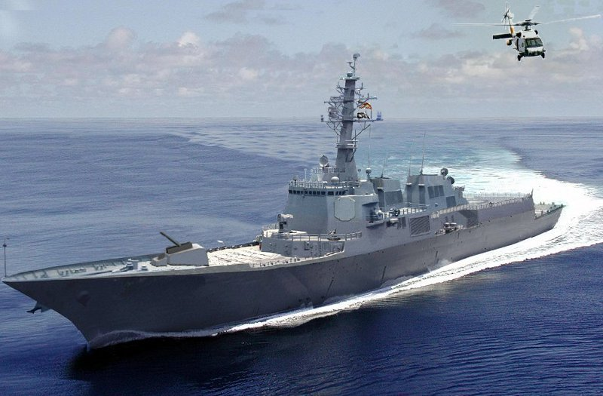
Shipboard Basics
Navy Ship
This material was produced under grant SH-05055-SH8- from the Occupational Safety and Health Administration, U.S. Department of Labor. It does not necessarily reflect the views or policies of the U.S. Department of Labor, nor does mention of trade names, commercial products or organizations imply endorsement by the U.S. Government.
Notes:
Shipboard Basics
READ:
The purpose of this class is to support you in navigating through a ship safely as well as provide awareness on what you should do in case of an emergency.
Read page.
Ask if any questions.

Slide 2
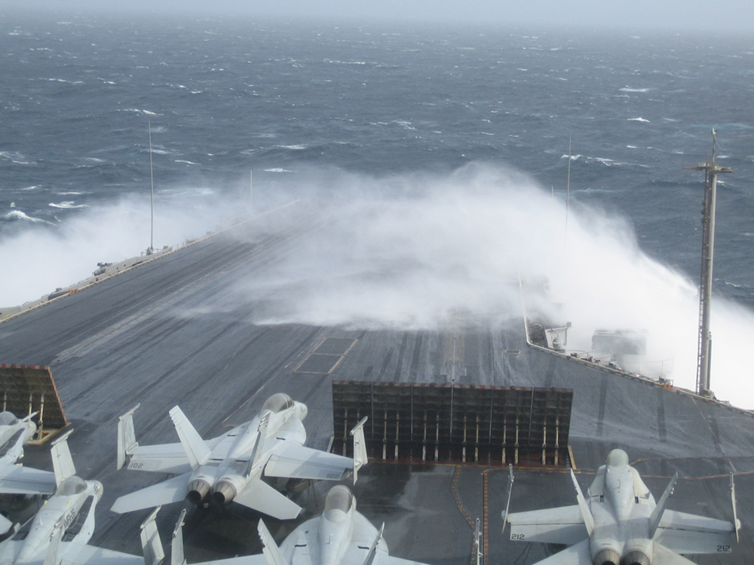
Topics
Deck of Aircraft Carrier with Planes
This material was produced under grant SH-05055-SH8- from the Occupational Safety and Health Administration, U.S. Department of Labor. It does not necessarily reflect the views or policies of the U.S. Department of Labor, nor does mention of trade names, commercial products or organizations imply endorsement by the U.S. Government.
Notes:
Topics
Read and review the topics to be covered.

Slide 3
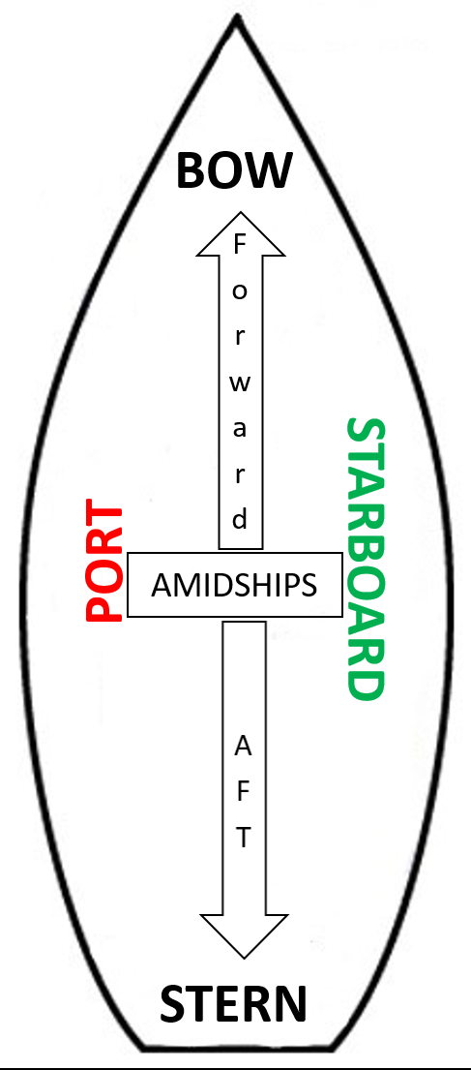
Ship Terminology
Ship Layout
Notes:
Ship Terminology
Read the words and definitions in this section.
Review each word by reading it and asking for a participant to read the corresponding answer.
Reinforce that these terms as vital to their navigation within a ship. Recommend that each participant review on their own to become very familiar with all these Ship Terminology.

Slide 4
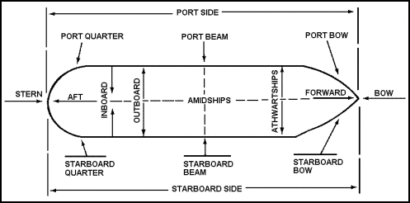
Ship Terminology con’t
Ship Layout
Notes:
Ship Terminology
Ask students to read the definitions
Select terms that correspond to the drawing above and point to each
location.
Ask if any questions.

Slide 5
Ship Terminology-Continued
Ship Layout
Notes:
Ship Terminology-Continued
Ask students to read the definitions
Select terms that correspond to the drawing above and point to each
location.
Ask if any questions.

Slide 6

Ship Navigation and Safety
Man With Video Camera
Notes:
Ship Navigation and Safety
Say – “As you watch the video, identify one or two facts regarding each of the following. Write your facts on the lines next to the term.
Review answers with the class.
Read and remind participants of the Note at the bottom of the page.
Ask if any questions.

Slide 7
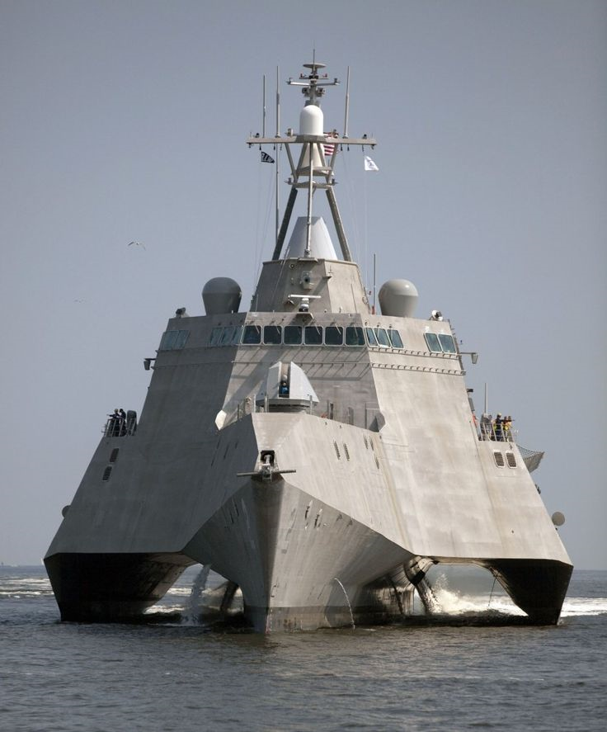
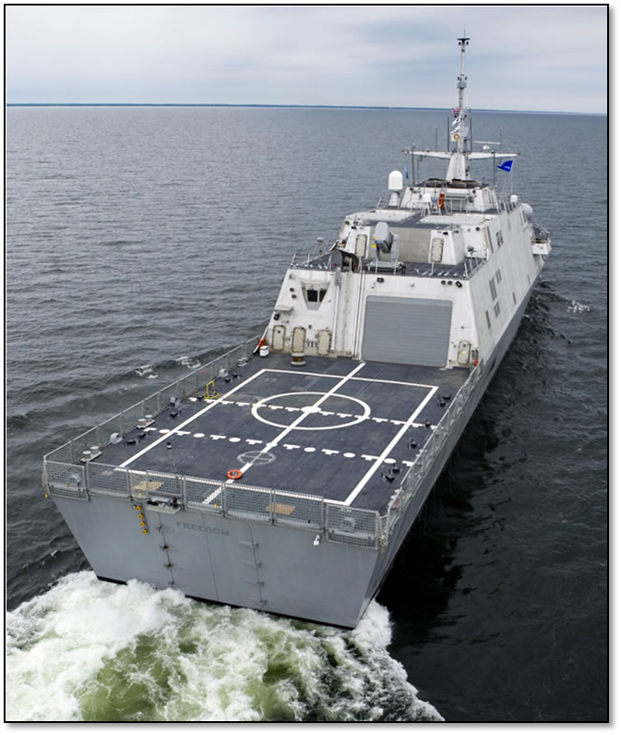
Bow and Stern
Front of Ship Back of Ship
Notes:
Bow and Stern
Read and remind participants the terms and use pointer to identify location on ship pictures and diagram.

Slide 8
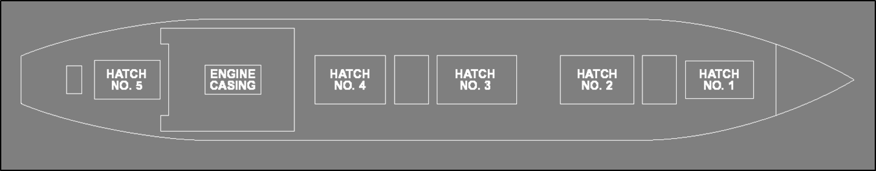
When looking forward
Port and Starboard
Port (Left Side)
Starboard (Right Side)
Notes:
Port and Starboard
Read and remind participants the terms and use pointer to identify location on ship diagram.

Slide 9
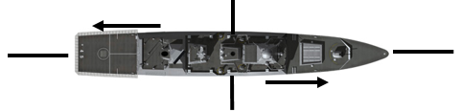
Terminology Exercise
Aerial View of Ship
Notes:
Terminology Exercise
Ask participants to write the appropriate letter below in the spaces above. Allow 1 minute. Review answers with the class.
Target answers above.
Port
Starboard
Stern
Bow
Aft
Forward
E
D
F
C
A
B

Slide 10
Decks
Different Decks of a Ship
Notes:
Decks
Ask a participant to read page.
Reinforce by saying:
Deck equals floor
Ceiling in any compartment is called “overhead”.
On all ships the uppermost deck is main deck.
Weather deck is exposed to weather.
Uppermost deck on aircraft carrier is flight deck.
Hanger deck on aircraft carrier is main deck.
Complete deck extends from side-to-side.

Slide 11
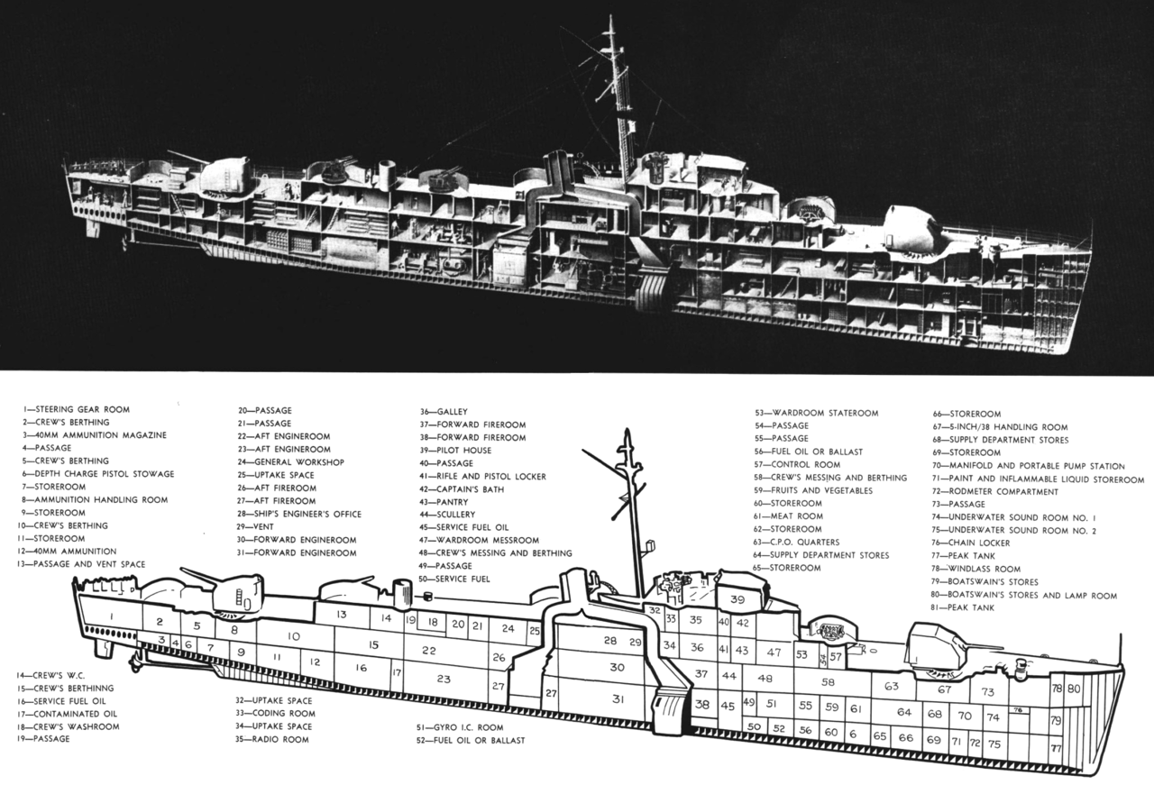
Ship Compartment Information
Cut Away Showing Many Ship’s Compartments
Notes:
Ship Compartment Information
Read this page.
Ask if any questions.

Slide 12
Centerline
Line Down the Center of a Ship
Centerline
Centerline
Notes:
Centerline
Point to the centerline in the diagram and read this page.

Slide 13
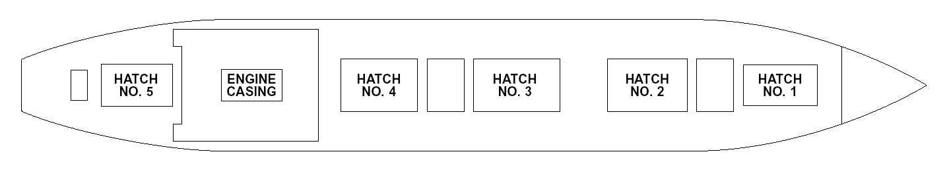
Outboard
Arrows Pointing Out From the Centerline
Notes:
Outboard
Read this page and point to the centerline outboard area in the diagram.

Slide 14
Inboard
Arrows Pointing Toward the Centerline
Notes:
Inboard
Read this page and point to the inboard area in the diagram.

Slide 15
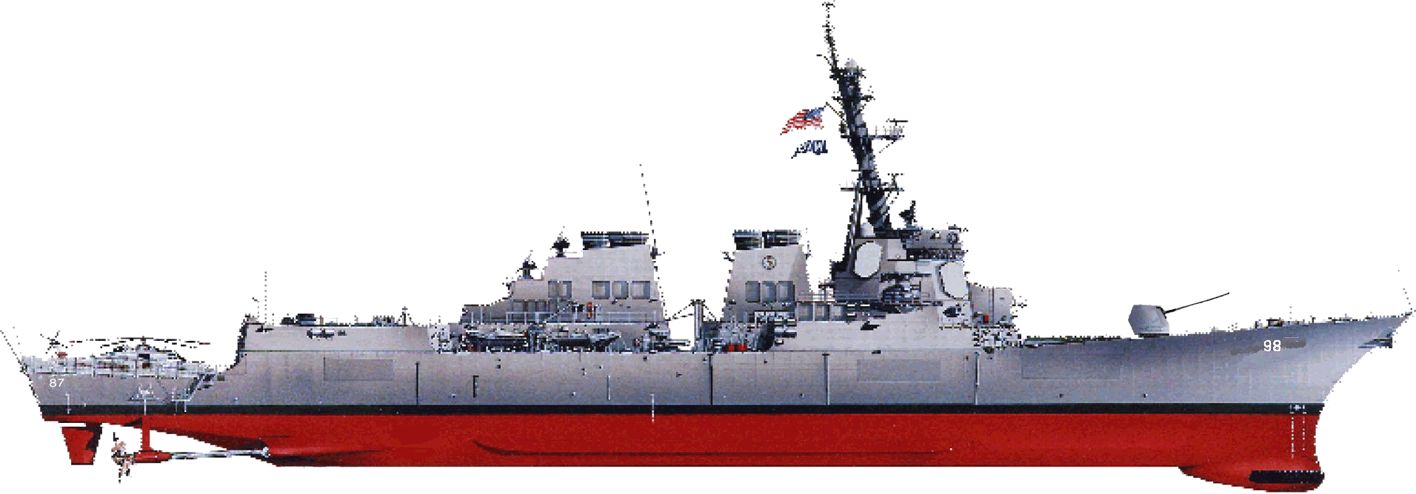
Midship
Line Halfway Between the Forward and Aft
Notes:
Midship
Read this page and point to the area in the diagram which is called midship.

Slide 16
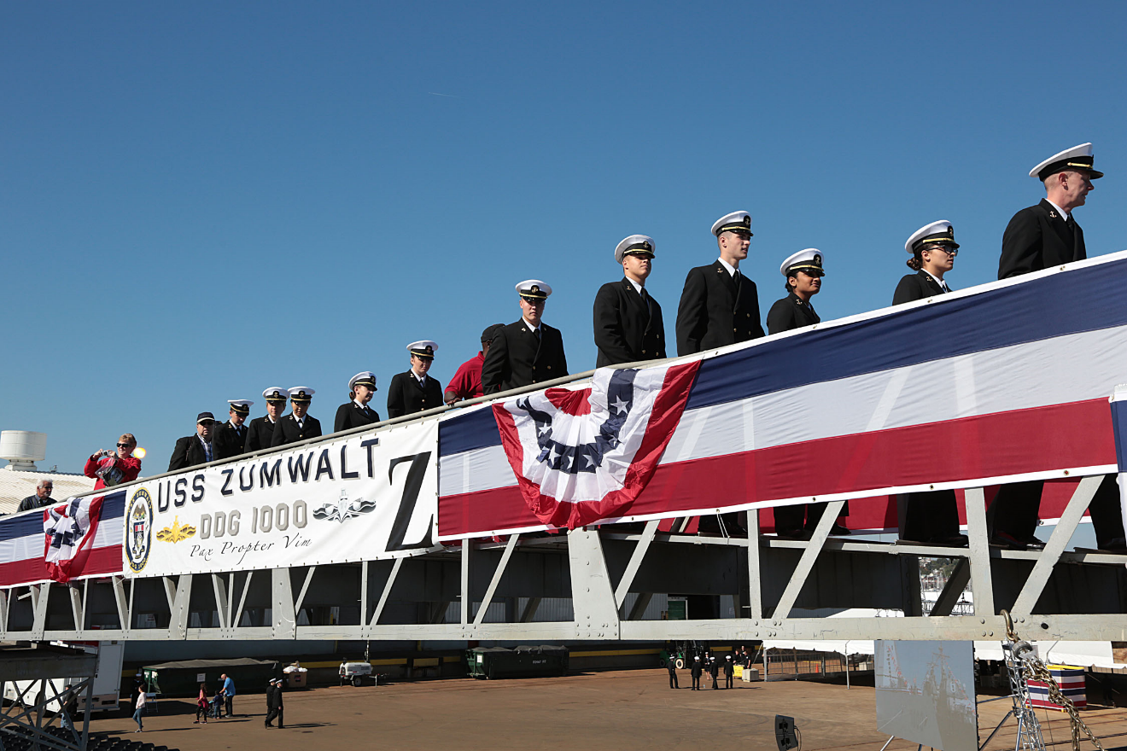
Brow or Gangway
Ships Personnel Embarking
Notes:
Brow or Gangway
Read this page.
Ask if any questions regarding outboard, inboard, midship, centerline, brow or gangway.

Slide 17
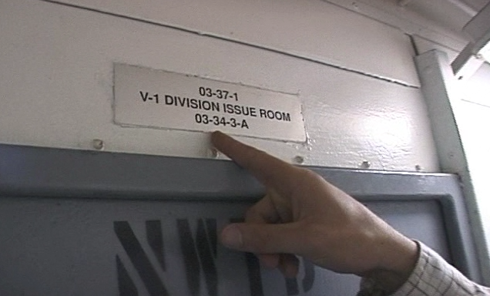
Compartment Numbering
Tac Number
Notes:
Compartment Numbering
Read this page.

Slide 18
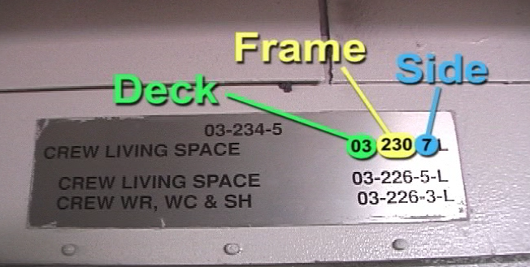
Compartment Numbering
Tac Number with Deck-Frame-Side
Notes:
Compartment Numbering
Review this numbering system. Use pointer if helpful.

Slide 19
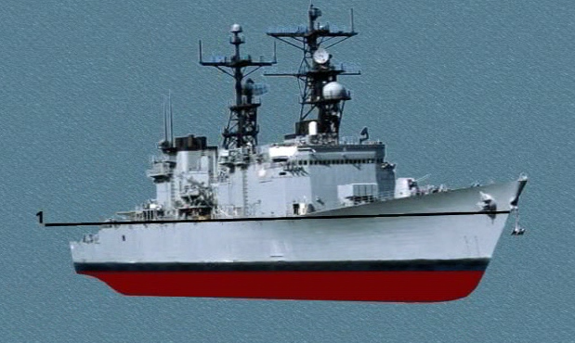
Deck Numbering
Ship with Numbered Decks
03_________________________
02___________________________
01_____________________________________
2____________________________________
3__________________________________
4__________________________________
Notes:
Deck Number
Review the two diagrams using the pointer:
The Main Deck is 1 (Except on an Aircraft Carrier – see below).
The first deck below the main deck is 2, while the second deck below is 3.
The first deck above the main deck is 01, the second is 02.

Slide 20

Frame Numbering
Ship with Numbered Frames
1 2 3 4
Notes:
Frame Numbers
Read this page.
Ask if questions.

Slide 21
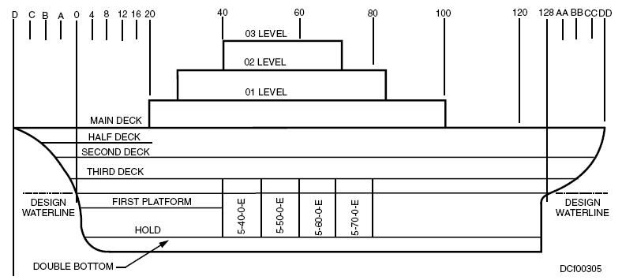
Decks and Frames Pop Quiz!
Ship with Deck and Frames Numbered
Flat.
Notes:
Decks and Frames Pop Quiz!
Target Answers in ALL CAPS ITALICS
Have participants complete the quiz.
Allow 1-2 minutes.
Discuss answers as a group .
A complete deck must go the entire length of the ship. Half decks may be referred to as FLATS ?
Find the Star.
What do the first two numbers designate? DECK and FRAME
What would the first two numbers of the next space (aft) be? 5 - 80
Find the First Platform.
What Frames does this platform span? 0 to 40
What deck is it located? 4.5

Slide 22
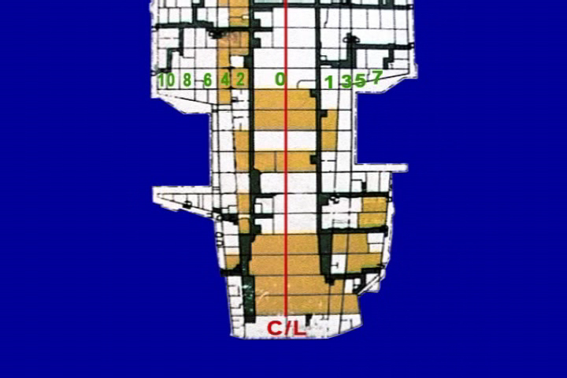
Centerline Relationship (Side)
Ship with Compartments Numbered by Side
1 2 3 4
Notes:
Centerline Relationship (Side)
Read this page.
Stop to review and use pointer after each compartment description.
Ask if questions.

Slide 23
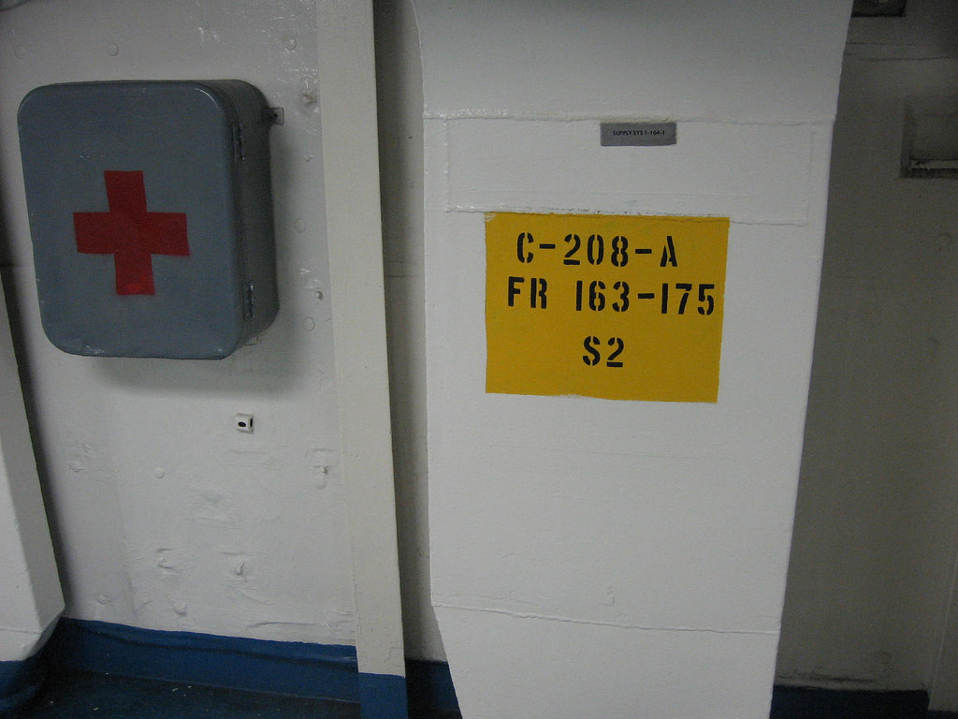
Compartment Type
Tac Number with Designating Type A
1 2 3 4
Notes:
Compartment Type
Ask participants to read to themselves..
Encourage participants to review/study these on their own.
Ask if there are questions.

Slide 24
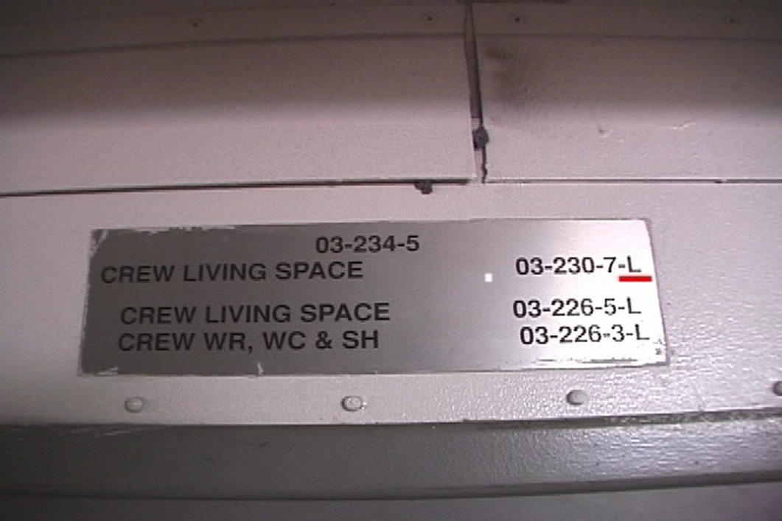
More Compartment Types
Tac Number with Underlined
1 2 3 4
Notes:
More Compartment Type
Ask participants to read to themselves..
Encourage participants to review/study these on their own.
Ask if there are questions.

Slide 25
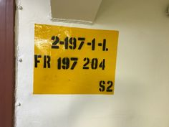
Quiz
Tac Number
1 2 3 4
Notes:
Quiz
Target answers in ALL CAPS ITALICS
Based on the Tac Number above:
Are you on the port or starboard side of the ship? STARBOARD
Are you likely close to the bow? NO
What deck are you on? 2
What type of space is it? LIVING QUARTERS

Slide 26
Where Are You?
Cutaway of Ship Tac Numbers and Star
2-10-2-A
2-30-0-L
2-30-1-L
2-20-0-L
2-1-0-A
2-10-1-A
2-20-1-L
Notes:
Where Are You?
Target answer below
If you are in the space designated by the star, what is your Tac Number?
2-20-0-L

Slide 27
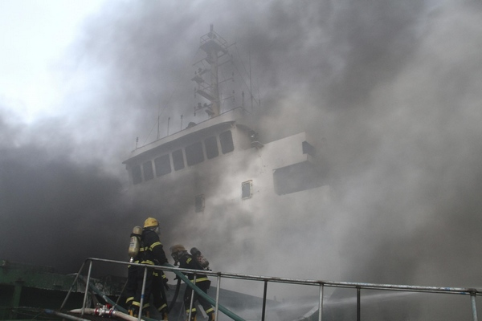
Hazards Found On-board
Fire Crew Putting Out Fire On-board a Ship
Notes:
Hazards Found On-board
State: “The following are types of workplace hazards you will find in the shipyard, on-board ship, and in your shop.”
Ask participants to circle the Physical Hazards they are exposed to.
Ask participants to share their answers with the class. Allow 1-3 to participate.
Play video and ask participants to list at least 4 shipyard hazards.

Slide 28
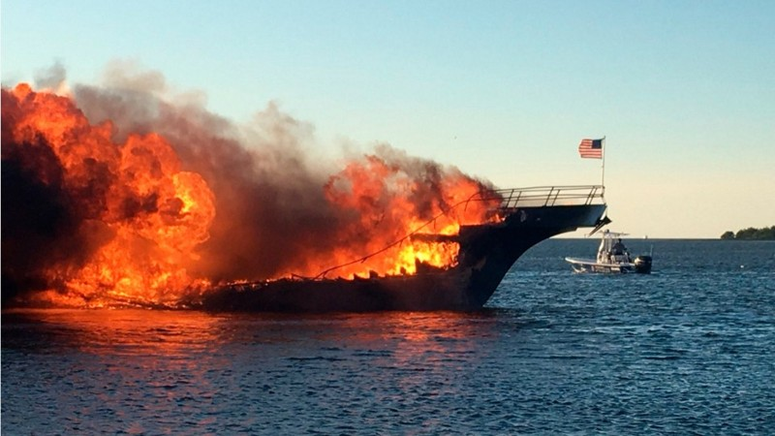
Emergency Response
Navy Ship On Fire
Notes:
Emergency Response
Ask for a volunteer to read this page.
Restate the type of emergencies listed .
Ask if any questions.

Slide 29
Emergency Response – Port of San Diego
Notes:
Emergency Response-Port of San Diego
Video Dos
_________________
_________________
_________________
_________________
_________________
_________________
_________________
_________________
Video Don’ts
_________________
_________________
_________________
_________________
_________________
_________________
_________________
_________________
A best practice is to report all close calls!

Slide 30
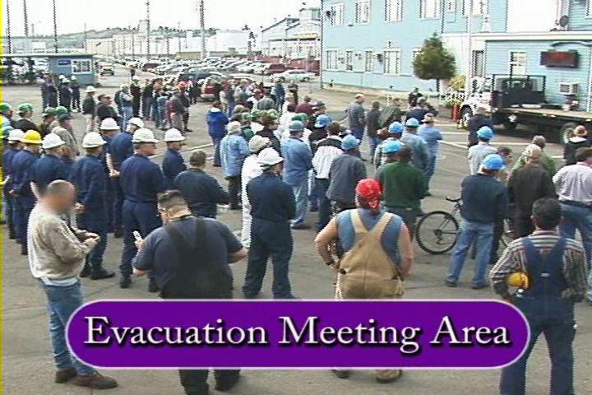
Muster Areas
Shipyard Workers at Muster Area
Notes:
Muster Areas
State: “Now we’re going to talk about Muster Areas.”
Read the first paragraph.
Ask the question: How many of you are familiar with this term or have participated in a “muster”?
Read the 2nd and 3rd paragraphs.
Emphasize the importance of NEVER leaving the muster area without letting your Supervisor know.

Slide 31
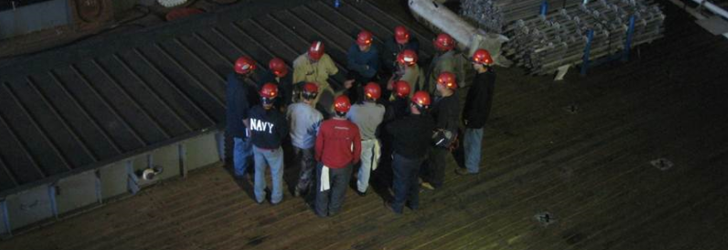
Emergencies in the Yard
Shipyard Workers In Training
Notes:
Emergencies in the Yard
Read this page.

Slide 32
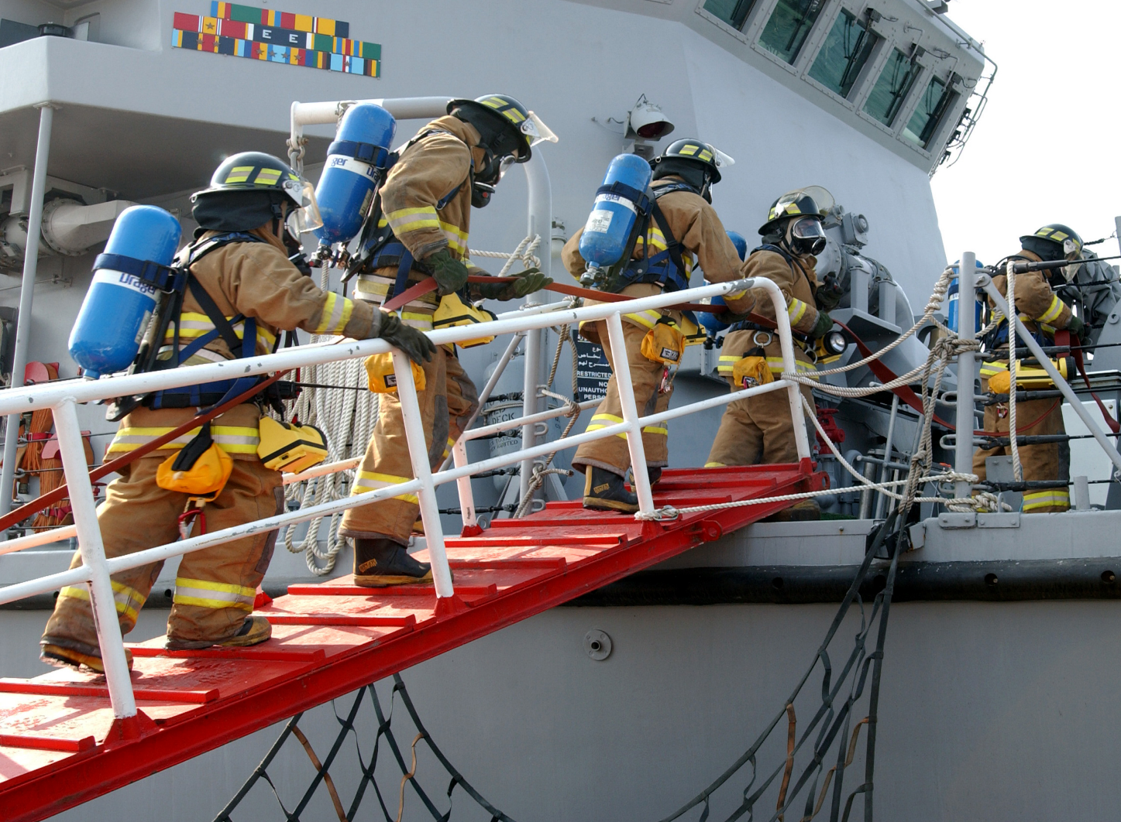
Navy Ship Emergency Alarms
Fire Crew Boarding Ship
Notes:
Navy Ship Emergency Alarms
Read the first paragraph.
Ask for a volunteer to read 1) General Alarm.
Ask for a volunteer to read 2) Fire Alarm.
Read 3) Machinery Space Alarm.
Ask if questions.
Thank volunteers.

Slide 33

More Navy Ship Alarms
Ship Capsized
Notes:
More Navy Ship Alarms
Ask for a volunteer to read 4) Machinery Space Co2 Alarm.
Ask for a volunteer to read 5) Cargo Space Co2 Alarm
Read 6) Abandon Ship Alarm.
Ask if questions.
Read and emphasize last paragraph.
Thank Volunteers.

Slide 34
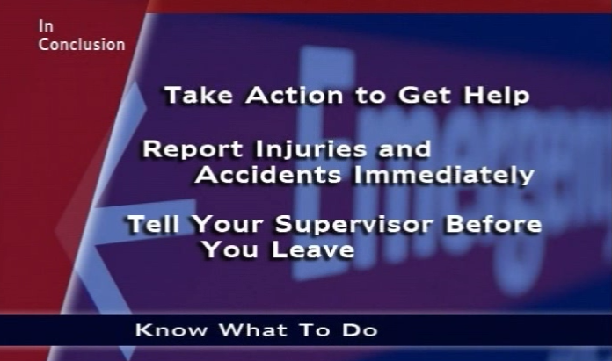
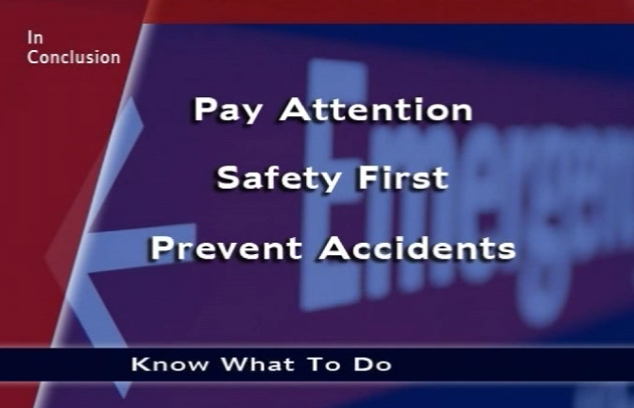
In Conclusion
Notes:
In Conclusion!
Review bullet points.
Ask if questions.

Slide 35

Questions or Comments
Notes:
Notes
____________________________________________________________________________________________________________________________________________________________________________________________________________________________________________________________________________________________________________________________________________________________________________________________________________________________________________________________________________________________________________________________________

