Slide 1
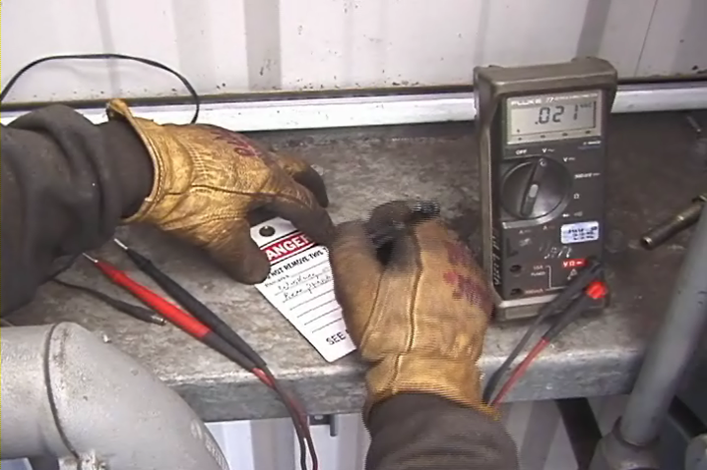
Electrical Safety /Lockout-Tagout
This material was produced under grant SH-05055-SH8- from the Occupational Safety and Health Administration, U.S. Department of Labor. It does not necessarily reflect the views or policies of the U.S. Department of Labor, nor does mention of trade names, commercial products or organizations imply endorsement by the U.S. Government.
Revisions were made to this material under grant number SH-05176-SH9 from the Occupational Safety and Health Administration, U.S. Department of Labor.
Notes:
1
Electrical Safety/Lockout-Tagout
An average of one worker is electrocuted on the job every day. Electricity is one of the most common causes of fire in homes and workplaces. Explosions have also resulted from electrical sources. There are four main types of electrical injuries:
Electrocution (death due to electrical shock)
Electrical shock
Burns
Falls
The following training content is subject to change as shipyard rules and governmental regulations change. You should follow your company’s procedures, rules and regulations. You should also study applicable OSHA (Federal and California) and NAVSEA standards and best practices before beginning work.

Slide 2
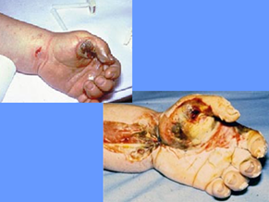
Topics Severely Burned Hand
This material was produced under grant SH-05055-SH8- from the Occupational Safety and Health Administration, U.S. Department of Labor. It does not necessarily reflect the views or policies of the U.S. Department of Labor, nor does mention of trade names, commercial products or organizations imply endorsement by the U.S. Government.
Notes:
Topics
Review the topics

Slide 3
General Training Content OSHA Logo
Notes:
General training content.
Explain that the next two pages are the OSHA regulations covering the training of Lockout Tagout.
Ask the participants to read the two pages and that you will cover each of these in this class.
Allow a few minutes for the participants to read.

Slide 4
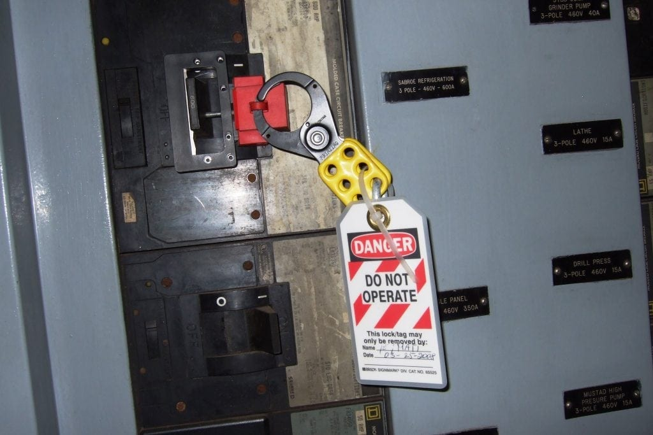
Additional Training Requirements Locked Out Circuit Breaker
Notes:
1915.89(o)(3)Additional training requirements for affected employees.
When they are finished reading ask if there are any questions and reiterate that each of these will be covered shortly.

Slide 5
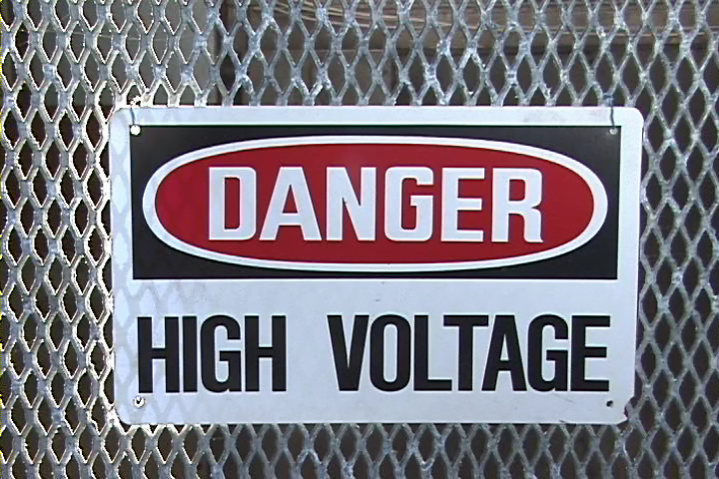
Common Terms – Amperes Danger High Voltage Sign
Notes:
Common Terms
Read, or ask a participant to read, the terms and definitions on this page.

Slide 6
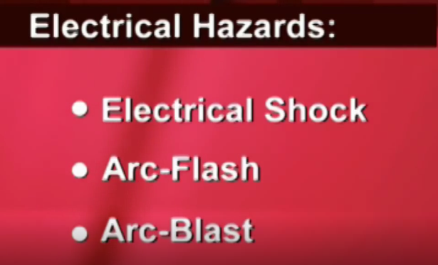
Common Terms – Grounding
Notes:
Common Terms
Ask for volunteers to read the terms on this page.
Thank the volunteers.
Ask if questions.

Slide 7
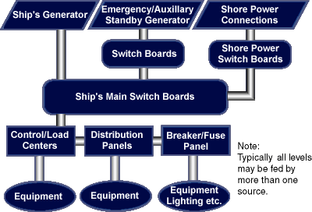
Electrical Sources On-Board Electrical Sources Flow Chart
Notes:
Electrical Sources On-Board (1915.181) (1915.157)
Say, “More OSHA standards…..state the1915.181 and 1915.157.”
Read the first paragraph. Using a pointer, ”walk-through” the diagram.
Read the 2nd paragraph.
Emphasize: Never plug into a ship’s power without permission.

Slide 8
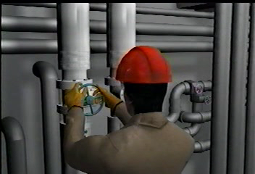
Non-Electrical Hazards Shipyard Worker Closing a Valve
Notes:
Non-Electrical Hazards-What Should Have Been Done Differently?
Have participants watch the video and make notes to answer this question.
Target Answer below
Personally check each valve that it was open and tagged.
Used a thermal gun to check for heat.
Don’t stand directly in front of the bolt you are removing.
Wear a face shield.
Remove bolt slowly.
Read the Source column and corresponding Shipyard Hazard column.

Slide 9
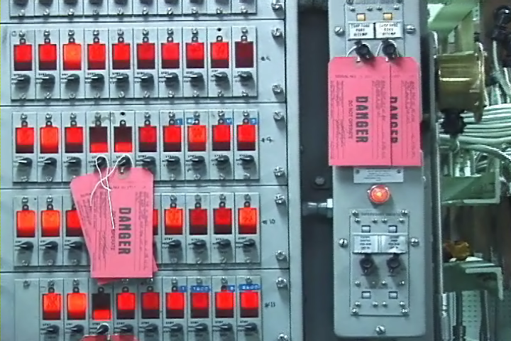
Lockout-Tagout Circuit Board With Red Tags
Notes:
Lockout-Tagout
Read this page.
Ask the Start up question!
Lockout-Tagout:
Requires a lock?
Requires a tag? Target Answer bold italics in RED Requires both?
It depends
Depends on whether doing shop work or work on-board a Navy ship.

Slide 10
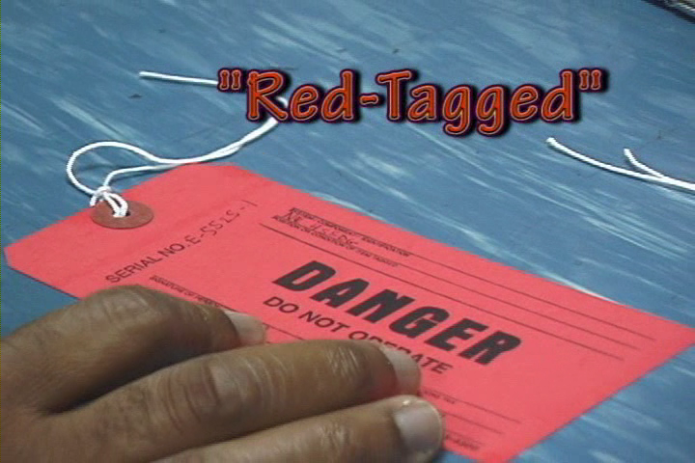
Terminology-Affected Employees Red Tag
Notes:
Ask for volunteers to read each term and definition.
Ask the question, “Who is authorized to “tag” a system or piece of equipment?”
Target Answer below
Authorized Employee – ONLY.
Ask, “What is the difference between an Affected and Authorized Employee?
Affected-Operator of equipment on which is being repaired or serviced.
Authorized-A person who does the lockout-tagout.
Say, “Only Ships Force can tag-out on a navy vessel.”

Slide 11
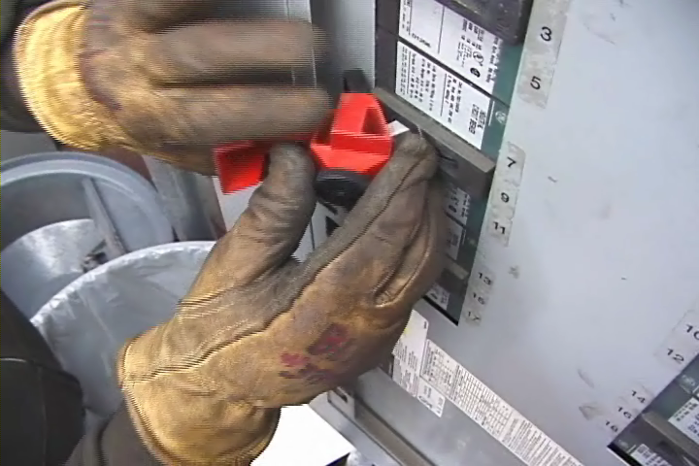
Overcurrent Devices Circuit Breaker
Notes:
Overcurrent Devices
Read this page.
Ask, “Is a GFCI an overcurrent device?”
Target Answer
No. A GFCI detects slight current imbalances between the hot and grounded conductors. It is used to protect people vs. equipment.
Ask if questions.

Slide 12
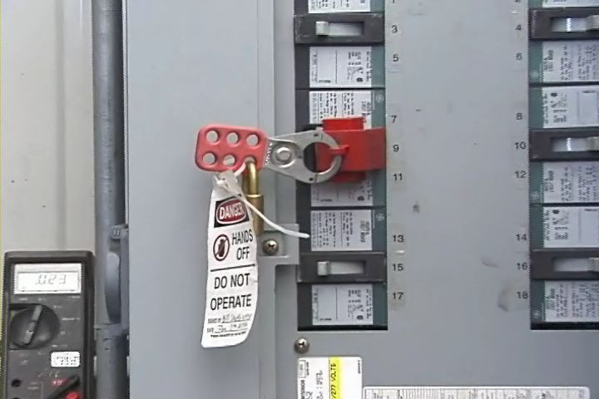
Key Word: De-Energize! Circuit Locked Out and Tagged
Notes:
Key Word: De-Energize! (1915.181)
Ask for volunteers to read each paragraph.
Thank volunteers.
Emphasize – ALWAYS CHECK AND CHECK AGAIN TO BE SURE A CIRCUIT IS DE-ENERGIZED.

Slide 13
Hazardous Energy Terminology
QUIZ!
Notes:
Target Answers below
Have the participants take this quiz by marking “T” for True and “F” for False. Allow 1-2 minutes. Review answers with the group.

Slide 14
Your Companies System Lockout Tagout Graphic
Notes:
Your Companies System
Read: The Lockout/Tagout Plus standard specifies that employers must: establish an energy-control program to ensure that only trained and authorized employees isolate machines from their energy sources and render them inoperative before performing service or maintenance.
General training content. The employer shall train each employee who is, or may be, in an area where lockout/tags-plus systems are being used so they know:
1915.89(o)(2)(i)
The purpose and function of the employer's lockout/tags-plus program and procedures;
1915.89(o)(2)(ii)
The unique identity of the locks and tags to be used in the lockout/tags-plus system, as well as the standardized color, shape or size of these devices;
Emphasize that this is specific to the organization they work for.
1915.89(o)(2)(iii)
The basic components of the tags-plus system: an energy-isolating device with a tag affixed to it and an additional safety measure;
1915.89(o)(3)(i)The use of the employer's lockout/tags-plus program and procedures;
Ask if there are questions.

Slide 15
Lockout Tagout Piers / Facilities Lockout Device
Notes:
Lockout Tagout Piers / Facilities
Read this page.
Ask if questions.

Slide 16
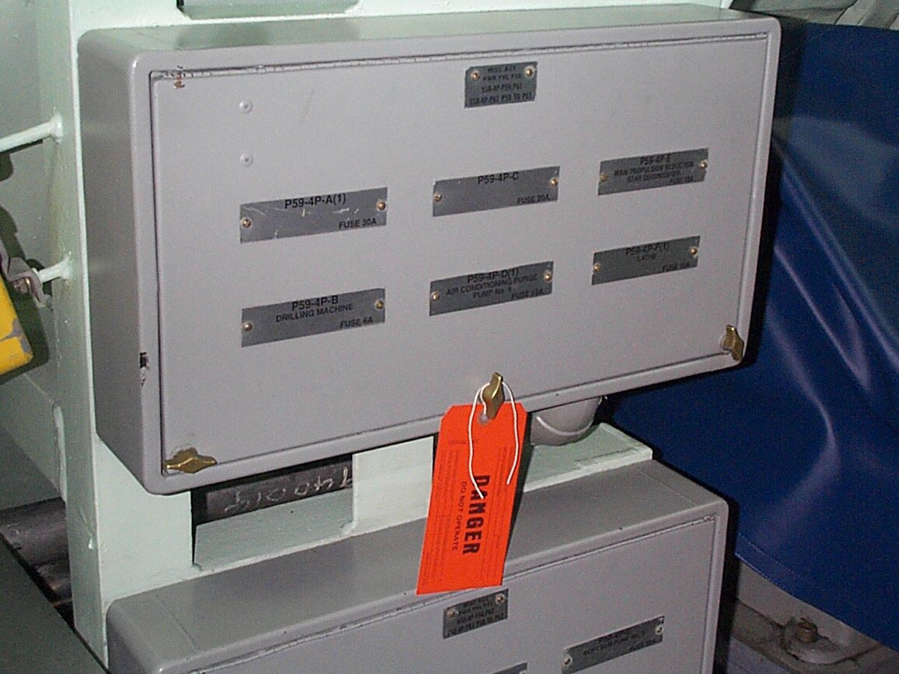
Tagging Out a Navy Vessel Improper Tagout
Notes:
Tagging Out a Navy Vessel
Read this page.
Use a pointer to identify the WRONG method of Tagout.
Ask, ”Why is this wrong?”
Target Answer below
Because you do not know which circuit is being worked on.

Slide 17
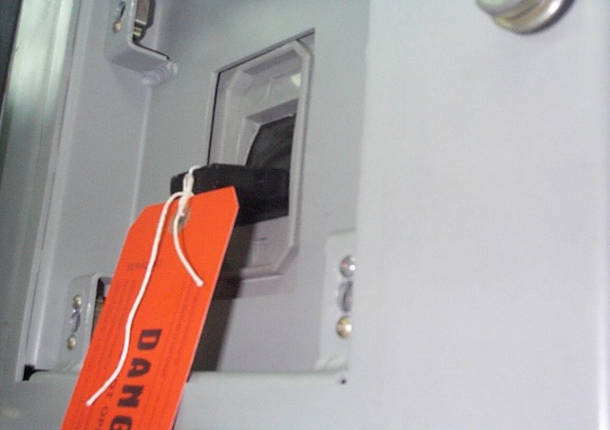
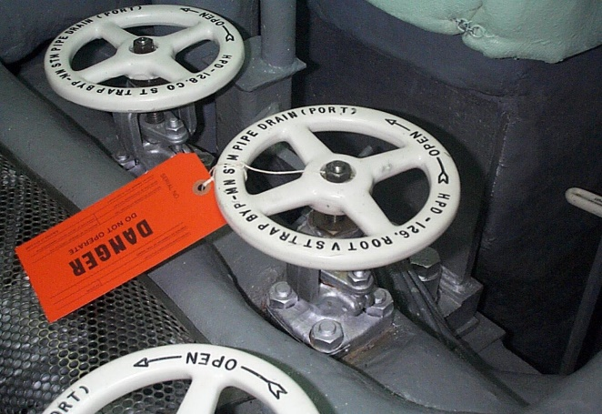
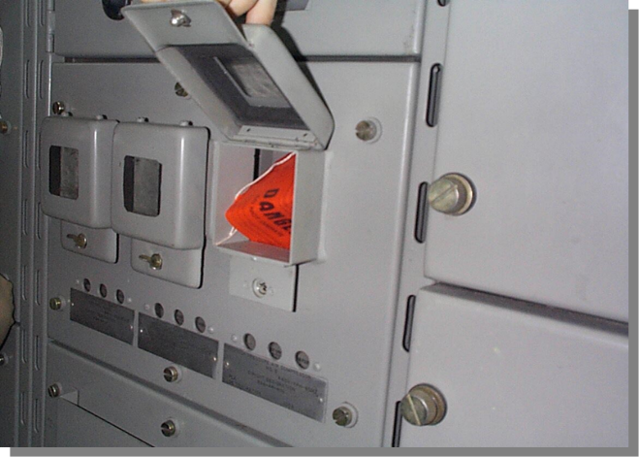
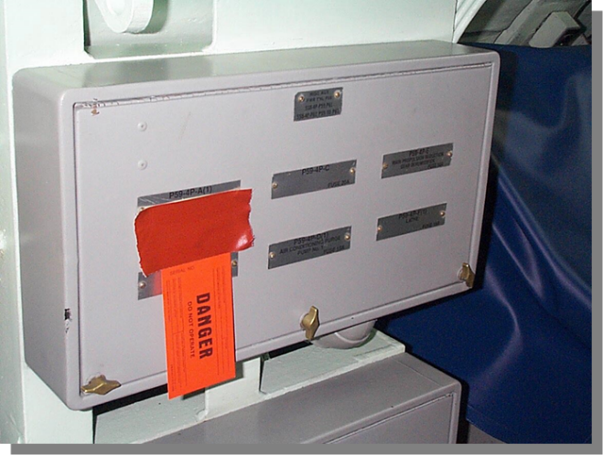
Proper Tag Attachment Correct Tagout Methods On Switches/Valves
Notes:
Proper Tag Attachment
Say, “Here are 4 examples of the CORRECT methods of Tagout.”
Ask a participant to read each one and as they do point to each one.
Ask if there are questions.

Slide 18
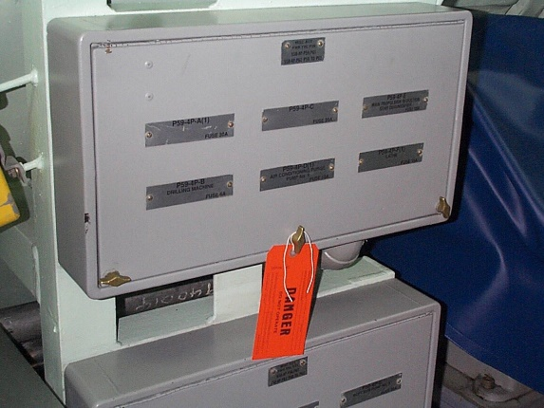
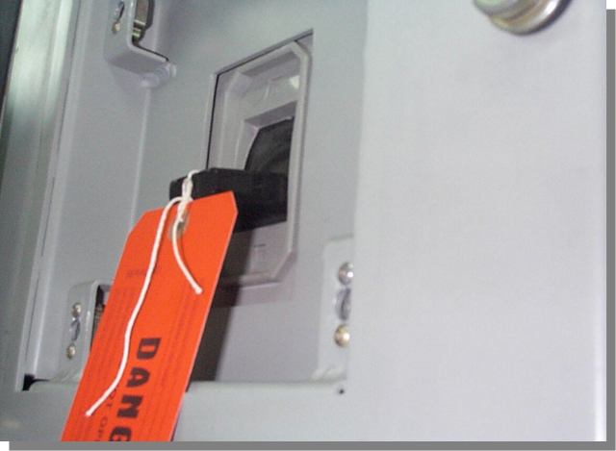
Quiz Tagout Methods On Switches / Valves
A
B
C
D
E
Notes:
Target Answers in ALL CAPS ITALICS
Which of the above is incorrect?
C
Is a tag an Administrative Control or an Engineering Control?
Administrative Control

Slide 19
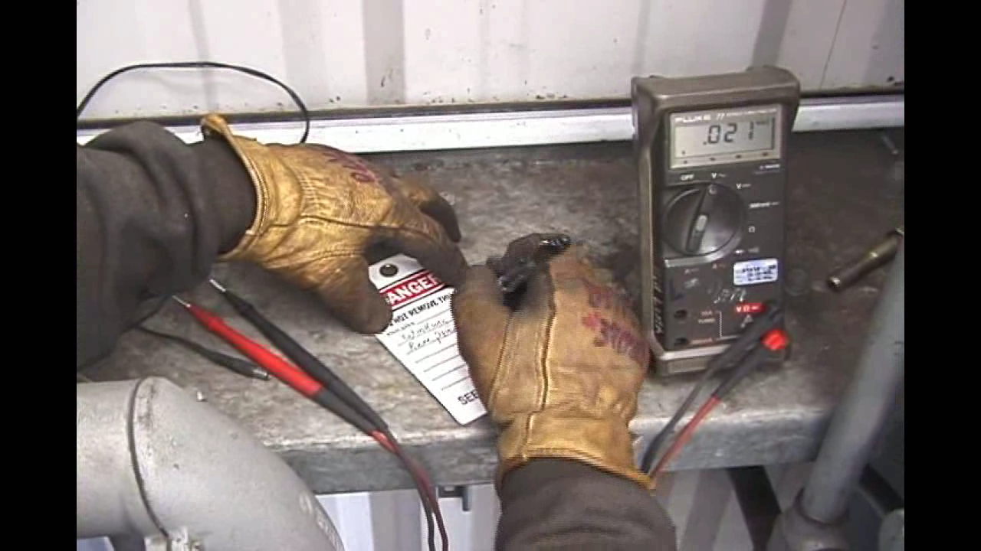
Dos and Don’ts Authorized Person Filling-Out A Tag
Notes:
Dos and Don’ts – Video
Explain that the participants are about to watch a video which will introduce some dos and don’ts regarding electrical safety and Lockout – Tagout. Ask that they listen carefully and try to list the 3 basic rules explained in the video.
After the video ask if there are questions.

Slide 20
The Five Basic Rules
Never
Work on an energized system
Operate any tagged device
Re-energize without proper tag-in
Lock or Tagout a device unless you are authorized
Tamper or remove a lock or a tag
Notes:
The Five Basic Rules
Tell the participants that the video identified 3 basic rules but, based on OSHA regulations, you will like to add 2 more.
Read this page.
Ask if there are questions.

Slide 21
Additional “Nevers”
Notes:
Never
Ask a participant to read this page.
Emphasize:
Non-compliance with, or violation of, these policies and/or procedures will result in immediate disciplinary action on the first offense up to and including termination
Ask if there are questions.

Slide 22
Dos Happy Face with Thumbs Up!
Notes:
Dos
Read the “Dos”.
Ask if questions.

Slide 23
Take Action!
Notes:
Take Action!
Say, “It’s everyone’s responsibility to be safe. You should take action when you find equipment that is defective, in need of repair or unsafe.”
Read the bullet points.
Ask for questions.

Slide 24
In Case Of An Emergency Cartoon of Man Being Shocked!
Notes:
In Case Of An Emergency
Read the page.
Emphasize if trained in CPR to begin immediately. Only if trained!

Slide 25
Training
Notes:
Training
Say, “This is the OSHA standard that requires training is to be conducted with any new employee that will be involved with shipboard tagout and all authorized employees annually..”
Say, “OSHA 1915.89(o)(7) is the OSHA standard that requires record keeping.”
Say, “OSHA 1915.89(o)(6) (i) through (iii) is the OSHA standard that defines the re-training of employees based on new job, equipment change, procedures changes…..and when there is evidence of lack of knowledge. Retraining must ensure employee knowledge and proficiency.”

Slide 26
Circle the best answer
QUIZ!
Notes:
Target Answers below
Ask participants to take the quiz. Allow 1 minute.
Target Answers below
Review answers with the class.
1. Which of devices below is not an overcurrent device
a) GFCI
2. One of the three Basic Rules is:
c) Both a and b
3. Who will remove tags and return to normal operation?
c) Ship’s Force

