Slide 1
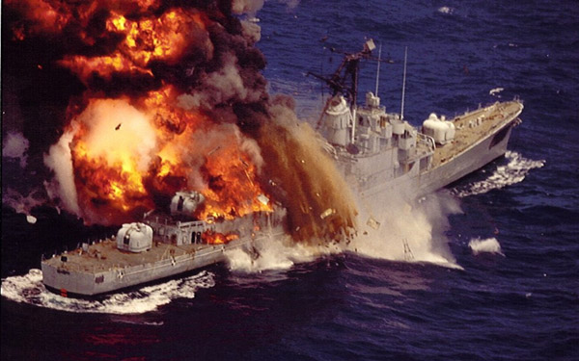
Preventing Fires and Hot Work
This material was produced under grant SH-05055-SH8- from the Occupational Safety and Health Administration, U.S. Department of Labor. It does not necessarily reflect the views or policies of the U.S. Department of Labor, nor does mention of trade names, commercial products or organizations imply endorsement by the U.S. Government.
Notes:
1
Preventing Fires and Hot Work
Fire on board is one of the most dangerous emergencies for a vessel.
There are serious risks for property and persons, as well as for the surrounding environment. On board ship there are tons of liquid fuel, electrical equipment, air-conditioning plants, engines, boilers, stores of flammable material and crew accommodation areas (kitchens, mess rooms, lounges, cabins, etc.). To all this we must add the load, which could be solid and liquid goods that are flammable or at least combustible, and often of a dangerous nature.
The best way to deal with fires on board ships is to prevent them rather than letting them occur.

Slide 2
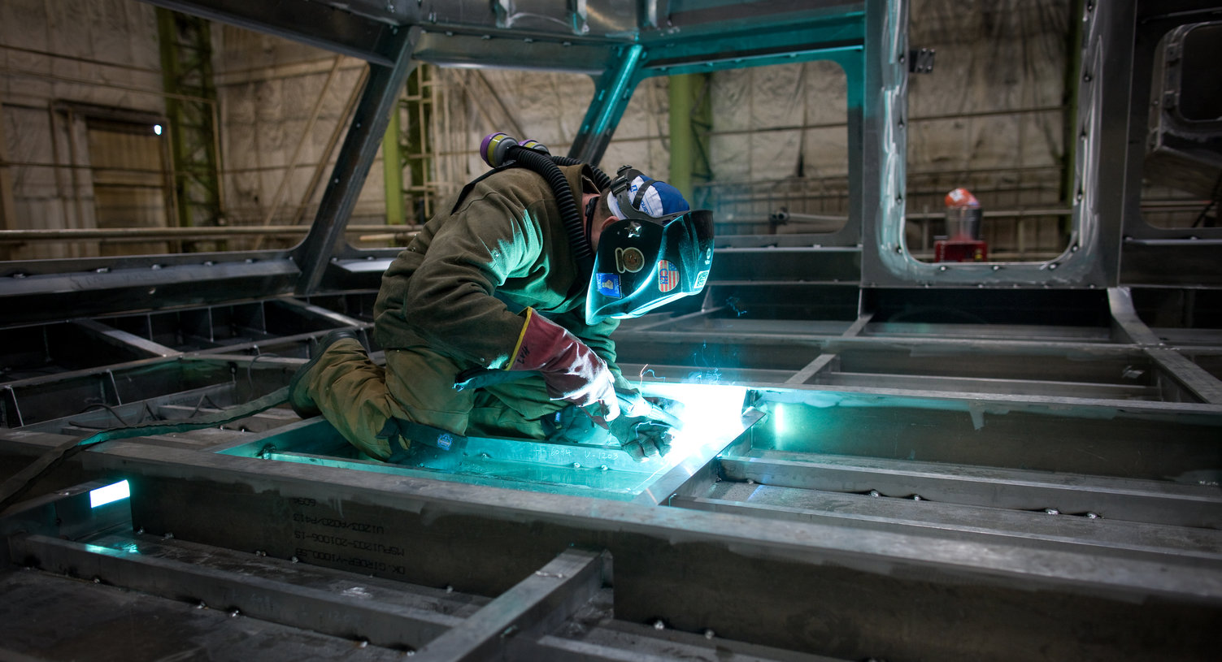
Topics
This material was produced under grant SH-05055-SH8- from the Occupational Safety and Health Administration, U.S. Department of Labor. It does not necessarily reflect the views or policies of the U.S. Department of Labor, nor does mention of trade names, commercial products or organizations imply endorsement by the U.S. Government.
Notes:
2
Topics
References
Hazards
Hot Work
PAI
Fire Watch
Quiz

Slide 3
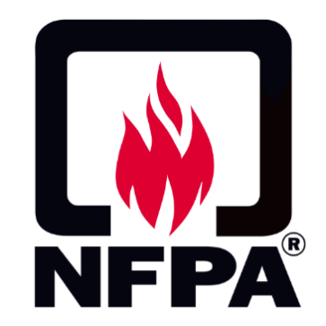
Applicable References Regulatory Bodies Logos
Notes:
References
NAVSEA Standard Item 009-07
29 CFR 1915, Occupational Safety and Health Standards for Shipyard Employment
NFPA 51B, Standard for Fire Prevention During Welding, Cutting, and Other Hot Work
NFPA 312, Standard for Fire Prevention of Vessels During Construction, Repair, and Lay-up

Slide 4
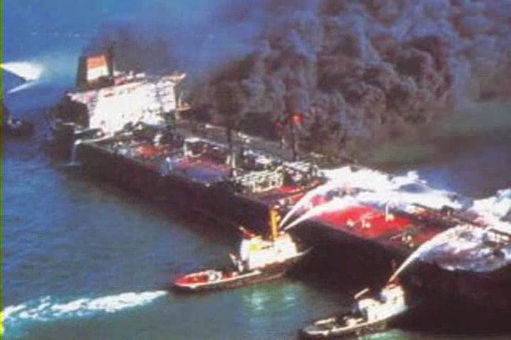
Hazards Ship Fire Being Extinguished
Notes:
On-Board Hazards
On-board a vessel the hazards are great. First, it is difficult to ventilate heat, smoke and the gases produced. Access is also restricted from:
The dock
Equipment
Tools
Vessel component
Additional problems are created for firefighters and fire responders, such as:
Adequate air supply
Build-up of water in the vessel
Dry dock stability

Slide 5
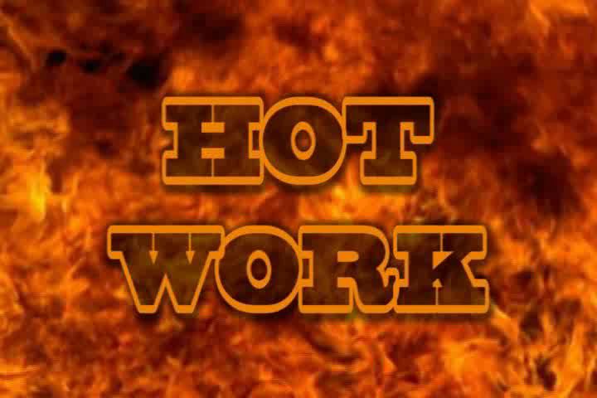
Hot Work Flames
Notes:
About Hot Work
Fires can seriously injure or kill you as well as cause millions of dollars worth of damage. Fires are usually caused by workers performing hot work.
What is Hot Work?
Hot Work is any activity involving:
Riveting, welding and allied processes, burning, the use of powder-actuated tools, heat treating, thawing pipe, heat-applied shrink wrapping, or similar fire-producing operations;
Any operation that raises the temperature of the work piece equal to or greater than 400°F or produces sparks.
Grinding, drilling, abrasive blasting, or similar operations producing or using a spark, flame, or heat. Grinding, drilling, abrasive blasting, or similar spark-producing operations should always be considered hot work when conducted in the presence of accumulated flammable gases, flammable or combustible liquids, their vapors, or accumulations of other common combustible materials.

Slide 6
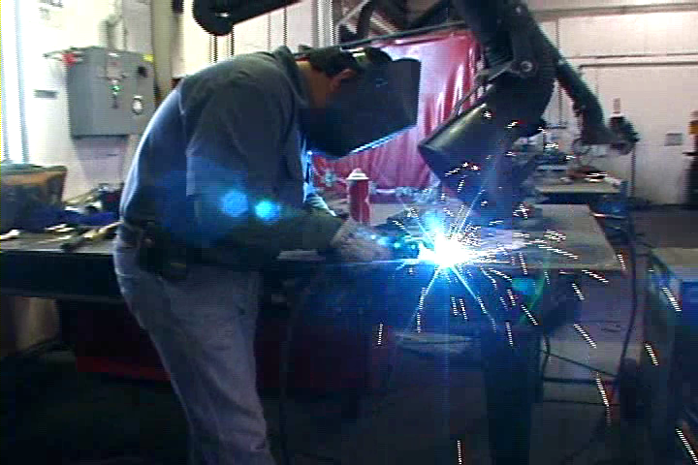
Your Hot Work Shipyard Worker Performing Hot Work
Notes:
Circle below the hot work tasks you perform or are exposed to while doing your job

Slide 7
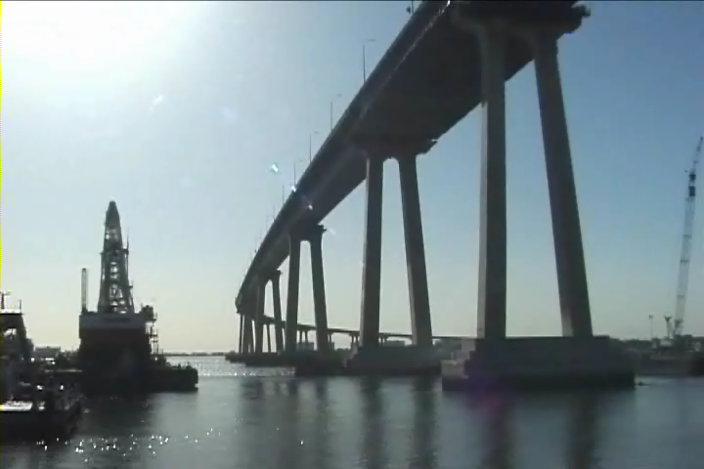
Working in Multiple Worksites Ship Near Coronado Bridge
Notes:
Host employer responsibilities (1915.501) (8 CCR 8397.10)
Inform employers about the content of the Fire Safety Plan including hazards, controls, fire safety and health rules, and emergency procedures. Ensure safety and health responsibilities for fire protection are assigned as appropriate to other employers at the worksite.
Contract employer responsibilities (1915.501) (8 CCR 8397.10)
Ensure host employer knows about the fire-related hazards associated with the contract employer's work and what the contract employer is doing to address them.
Advise the host employer of any previously unidentified fire-related hazards that the contract employer identifies at the worksite.
Have a qualified Permit Authorizing Individual (PAI)!
Contract employers in shipyard employment must have a Fire Safety Plan for their employees, and this plan must comply with OSHA requirements (Federal and State) as well as the host employer’s Fire Safety Plan.

Slide 8
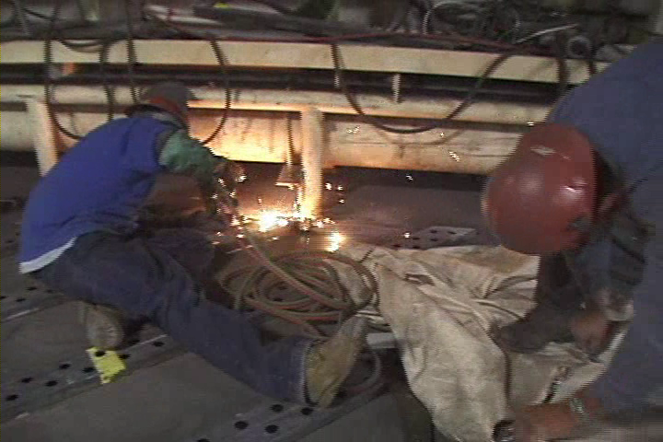
Hose Lines and Torches Two Workers Working with Lines and Torches
Notes:
Gas/Oxygen Supply Lines and Torches (1915.503) (8 CCR 8397.14)
Gas and oxygen leaks have caused explosions, serious fire injuries and deaths. When working with fuel gas and oxygen supply lines & torches it is critical that there are:
No unattended fuel gas and oxygen hose lines or torches in confined spaces; when you leave a confined space they must be removed!
No unattended fuel gas and oxygen hose lines or torches in enclosed spaces for more than 15 minutes
It is also important that:
All fuel gas and oxygen hose lines are disconnected at the supply manifold at the end of each shift and rolled back to open air
(8 CCR 8397.14)
(D) All disconnected fuel gas and oxygen hose lines are rolled back to the supply manifold or to open air to disconnect the torch; or extended fuel gas and oxygen hose lines are not reconnected at the supply manifold unless the lines are given a positive means of identification when they were first connected and the lines are tested using a drop test or other positive means to ensure the integrity of fuel gas and oxygen burning system.

Slide 9
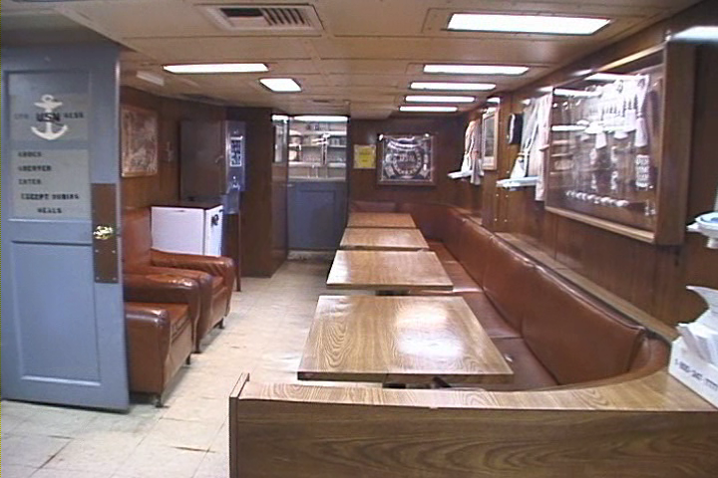
Flammables and Combustibles Room with Furniture
Notes:
Flammable and Combustibles
When performing hot work all flammable and combustible material must be cleared (at least 35 feet from hot work) or protected. Remove:
Liquid flammables and combustibles
Papers
Boxes
Trash/clutter
When flammable items cannot be removed, such as carpet or furniture, use a fire retardant cloth to protect them.
Be sure all aisles and passageways are clear. Re-inspect area after extended breaks.
This will be done at the direction of the PAI.

Slide 10
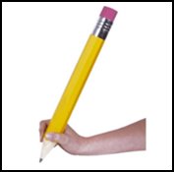
Hot Work
QUIZ!
Notes:
10
For each statement below circle T for True or F for False. All statements relate to shipboard work.

Slide 11
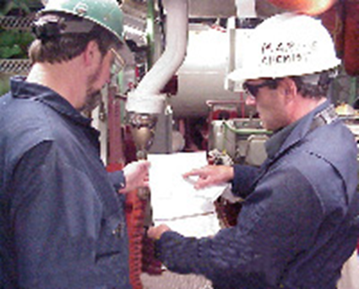
The PAI Two Workers Discussing Form
Permit
Authorizing
Individual
Notes:
The Permit Authorizing Individual (PAI)
The Port of San Diego Ship Repair Association and its members have agreed upon the following:
All companies conducting hot work aboard a military vessel will have a Permit Authorizing Individual (PAI). This individual is designated by management to authorize hot work and has successfully completed required training in accordance with company policy. The PAI cannot be the hot work operator. The PAI must be aware of the fire hazards involved and is familiar with the provisions of the company policy and all applicable references.
The PAI Authority
Start of hot work if safe conditions are met
Stop hot work if unsafe conditions found

Slide 12
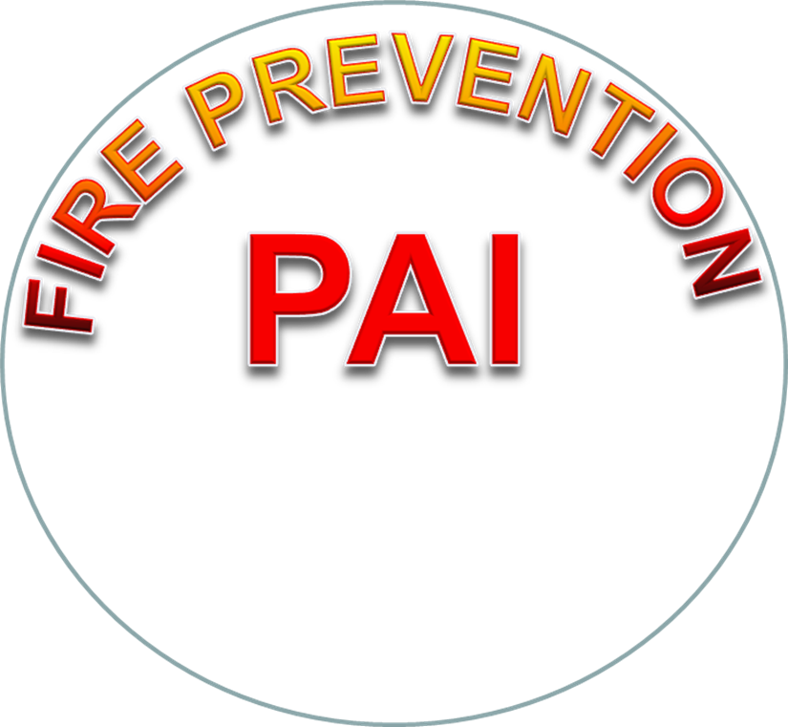
PAI Duties
Notes:
More on the Permit Authorizing Individual
Additionally:
The PAI must be trained in their duties
The PAI must be a Competent Person as defined by NAVSEA 009-07 (SYCP)
The PAI must approve all hot work on the Work Authorization Form (WAF) and the associated Chit
NFPA 51 B PAI – Duties and Responsibilities of the PAI:
Completes and approves the Hot Work permit
Determines hazards
Determines required PPE
Approves methods and schedules
Determines fire protections and extinguisher equipment operation and location
Fire Watch requirements
Communication lines between fire watch and hot worker

Slide 13
PAI/Hot Worker Reference Guide
Notes:
The PAI/Hot Worker Reference Guide
Printed on the back of the permit posted at the space

Slide 14
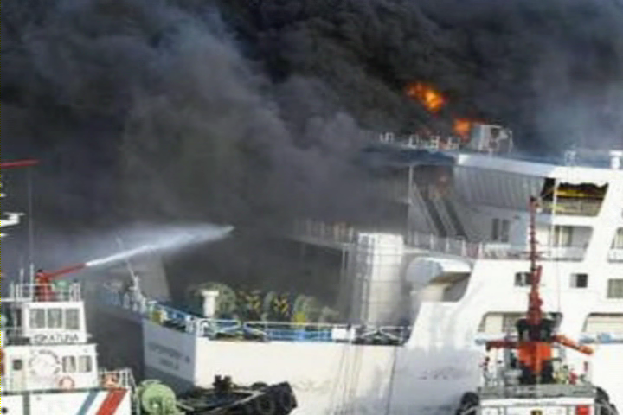
Fire Watch Policy Ship Fire Being Extinguished
Notes:
Fire Watch Policy (1915.504) (8 CCR 8397.15)
The employer must create and keep current a written policy that specifies the following requirements for employees performing fire watch in the workplace:
The training provided to employees detailing requirements
The duties employees are to perform
The equipment employees must be given
The personal protective equipment that must be made available and worn
The conditions when a fire watch is required
Note: A fire watch must have an identifiable means demonstrating they are a certified fire watch (typically a sticker, vest or card).
A fire watch cannot be assigned any other duties.

Slide 15
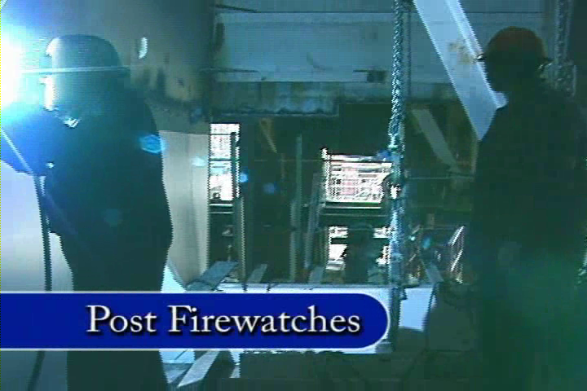
Posting a Fire Watch Fire Watch Observing a Welder
Notes:
Posting of a Fire Watch On-Board a Navy Ship (Navy Requirement)
In ship repair conducted on US Navy ships a fire watch is required any time hot work is conducted
Posting a Fire Watch – New Construction and Commercial Vessels (1915.504) (8 CCR 8397.15)
In new construction and commercial ship repair post a fire watch if hot work is close enough to cause ignition through heat radiation or conduction on the following:
Insulated pipes, bulkheads, decks, partitions, or overheads
Combustible materials and/or coatings
Hot work is close enough to unprotected combustible pipe or cable runs to cause ignition
A Marine Chemist, a Coast Guard authorized person, or a shipyard Competent Person, as defined in 29 CFR Part 1915, Subpart B, requires that a fire watch be posted (8 CCR 8397.14)

Slide 16
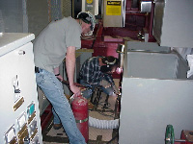
Duties of a Fire Watch Worker Handling a Fire Extinguisher
Notes:
Duties of a Fire Watch (1915.504) (8 CCR 8397.15)
The employer must not assign other duties to a fire watch while the hot work is in progress!
Employee assigned to fire watch:
Must have a fully charged, and sealed, fire extinguisher and be trained to use it! Extinguisher must be within 5 feet of the person
Must have a clear view of, and immediate access to, all areas included in the fire watch. Can only watch 4 workers with a clear view of all!
If multiple blind compartments are involved in any hot work job, fire watches shall be posted simultaneously in each blind area
Are able to communicate with workers exposed to hot work
Are authorized to stop work if necessary and restore safe conditions within the hot work area
Remain in the hot work area for at least 30 minutes after completion of hot work (unless the employer or its representative surveys the exposed area and makes a determination that there is not further fire hazard

Slide 17
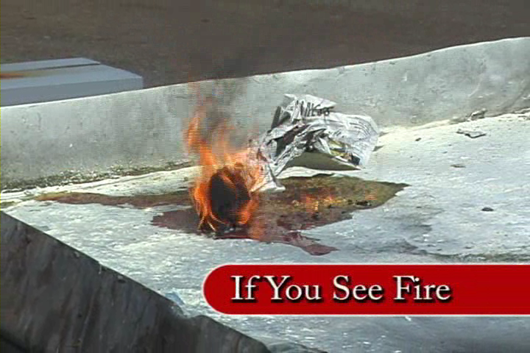
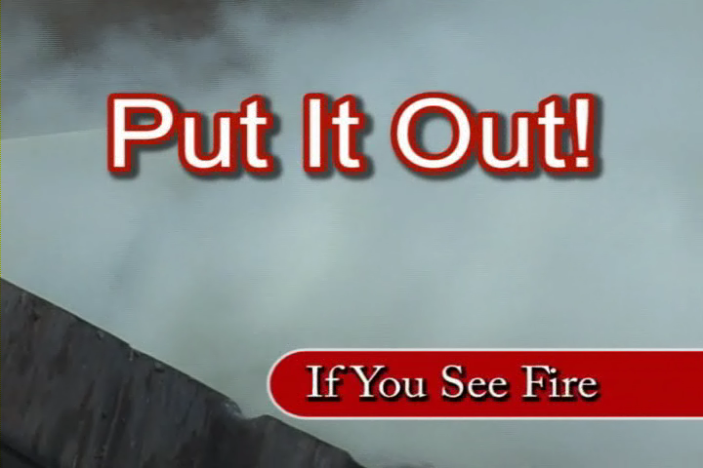
More Fire Watch Duties Paper on Fire
Notes:
Duties of a Fire Watch Continued (1915.504) (8 CCR 8397.15)
Are trained to detect fires that occur
Attempt to extinguish any incipient (incipient means beginning to exist)
stage fire in the area
Alert employees of any fire beyond the incipient stage
If unable to extinguish fire in the areas exposed to the hot work, activate the alarm
Note: Employer must ensure that employees assigned to fire watches are physically capable of performing these duties.
* Note: The fire watch is not a replacement for proper planning to prevent conditions that allow a fire to develop, regardless of the fire-fighting equipment available and the capabilities of the individual involved.

Slide 18
Fire Watch Exercise Ship Drawing With Numbered Spaces
Notes:
18
Fire Watch Exercise
If you were welding in the corner where the red dot is above (1S), where would you need to post a fire watch?

Slide 19
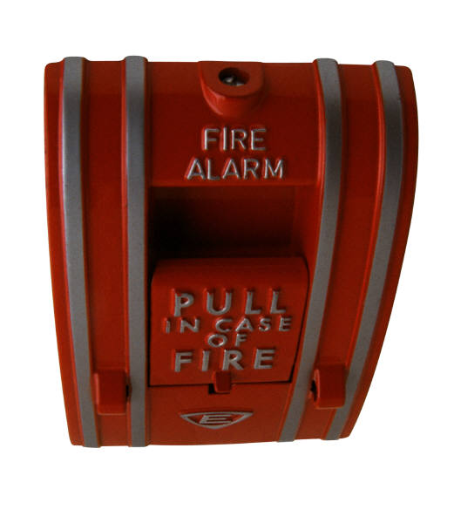
Responding to a Fire Fire Extinguisher
Notes:
Responding to a Fire
A significant part of your company’s Fire Safety Plan is the emergency response section. In time of emergency, you can’t depend on your supervisor to tell you what to do. They may be off duty that day, at another site, or busy doing something else in response to the emergency.
You need to:
Know where the emergency response plan is located
Be trained on emergency response
Know what to do
Know where to go and what to do at all of your work locations

Slide 20
Muster Areas Shipyard Workers at Muster Area
Notes:
Muster Areas
For a small operation the staging (muster) area may just be the building parking lot. Aboard ship it may be the dry dock. If you work in a multi-story building, a more specific location is needed, such as a particular corner or in front of a specific store, etc. Know where your muster area is located in the yard and on-board! All yards have alarms (not the same!) and some are followed by voice commands. On board, listen to the voice commands before you move to your muster area!
Note: In case of a potential disaster like a threatened building collapse or explosion, as in the World Trade Center situation, the local fire or police officers may order immediate evacuation of all nearby areas.
Important: Supervisors are responsible for accounting for everyone so that rescue personnel don’t end up going needlessly into a burning building or one threatening to collapse. Never leave the muster area without letting the Supervisor know.

Slide 21
Fire Watch/Fire Response
QUIZ!
Notes:
21
For each statement below circle T for True or F for False. All statements relate to shipboard work.

