Slide 1
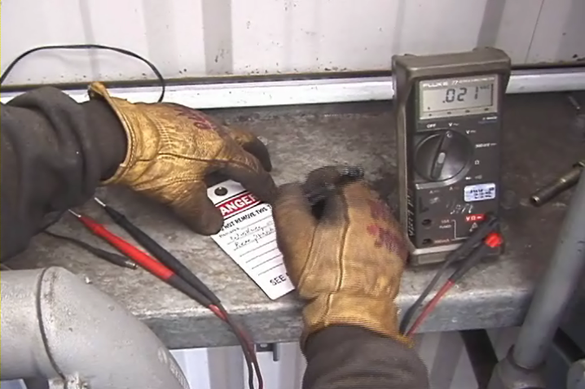
Electrical Safety /Lockout-Tagout
This material was produced under grant SH-05055-SH8- from the Occupational Safety and Health Administration, U.S. Department of Labor. It does not necessarily reflect the views or policies of the U.S. Department of Labor, nor does mention of trade names, commercial products or organizations imply endorsement by the U.S. Government.
Revisions were made to this material under grant number SH-05176-SH9 from the Occupational Safety and Health Administration, U.S. Department of Labor.
Notes:
1
Electrical Safety/Lockout-Tagout
An average of one worker is electrocuted on the job every day. Electricity is one of the most common causes of fire in homes and workplaces. Explosions have also resulted from electrical sources. There are four main types of electrical injuries:
Electrocution (death due to electrical shock)
Electrical shock
Burns
Falls
The following training content is subject to change as shipyard rules and governmental regulations change. You should follow your company’s procedures, rules and regulations. You should also study applicable OSHA (Federal and California) and NAVSEA standards and best practices before beginning work.

Slide 2
Topics Severely Burned Hand
This material was produced under grant SH-05055-SH8- from the Occupational Safety and Health Administration, U.S. Department of Labor. It does not necessarily reflect the views or policies of the U.S. Department of Labor, nor does mention of trade names, commercial products or organizations imply endorsement by the U.S. Government. Revisions were made to this material under grant number SH-05176-SH9 from the Occupational Safety and Health Administration, U.S. Department of Labor.t.
Notes:
Topics
OSHA Requirements
Terminology
Non-Electrical Hazards
Protective Devices and Processes
Your Company's Requirements
Lockout-Tagout
Summary

Slide 3
General Training Content OSHA Logo
Notes:
General training content. The employer shall train each employee who is, or may be, in an area where lockout/tags-plus systems are being used so they know:
1915.89(o)(2)(i)
The purpose and function of the employer's lockout/tags-plus program and procedures;
1915.89(o)(2)(ii)
The unique identity of the locks and tags to be used in the lockout/tags-plus system, as well as the standardized color, shape or size of these devices;
1915.89(o)(2)(iii)
The basic components of the tags-plus system: an energy-isolating device with a tag affixed to it and an additional safety measure;
1915.89(o)(2)(iv)
The prohibition against tampering with or removing any lockout/tags-plus system; and
1915.89(o)(2)(v)
The prohibition against restarting or reenergizing any machinery, equipment, or system being serviced under a lockout/tags-plus system.

Slide 4
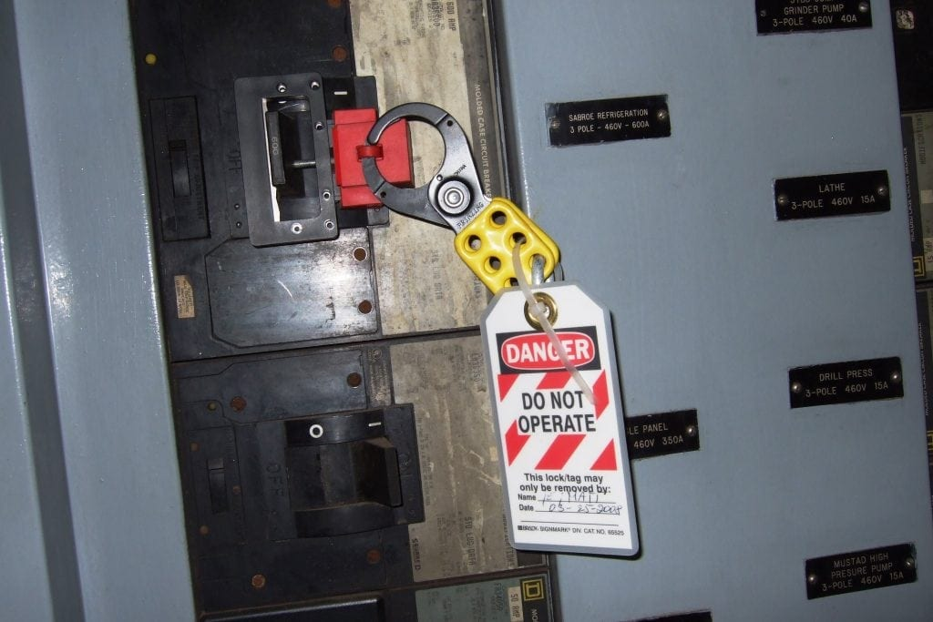
Additional Training Requirements Locked Out Circuit Breaker
Notes:
1915.89(o)(3)Additional training requirements for affected employees.
In addition to training affected employees in the requirements in paragraph (o)(2) of this section, the employer also shall train each affected employee so he/she knows:
1915.89(o)(3)(i)The use of the employer's lockout/tags-plus program and procedures;
1915.89(o)(3)(ii)That affected employees are not to apply or remove any lockout/tags-plus system; and
1915.89(o)(3)(iii)That affected employees are not to bypass, ignore, or otherwise defeat any lockout/tags-plus system.

Slide 5
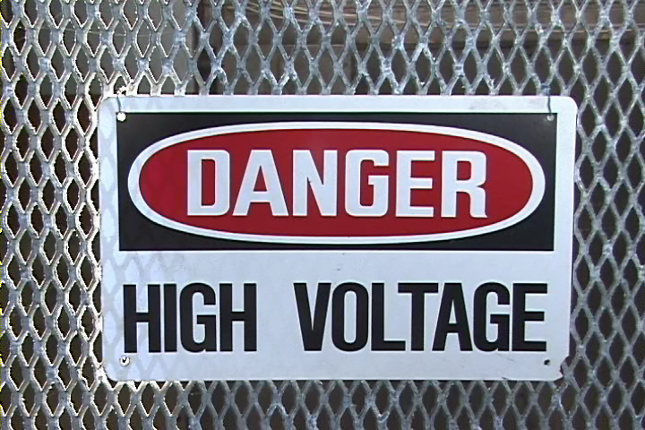
Common Terms – Amperes Danger High Voltage Sign
Notes:
Common Terms
Amperes (Amps)– Amperage (A) is a measure of current flow, i.e., how many electrons flow through something per second. One amp is about 6 million trillion electrons per second. This flow of electrons is what actually causes tissue or nervous system damage. All those electrons passing through a body either burn tissues or interfere with essential electrical signals, such as those that cause the heart to beat.
The latter phenomenon is why an electrocution above a certain amperage will cause your muscles to clench and make it impossible for a person to let go of the current source. Being physically unable to let go of a live wire is called tetanic contraction.
Conductors – substances, such as metals, that have little resistance to electricity
Current – the movement of electrical charge
Electric shock – See amperes (Amps) above

Slide 6
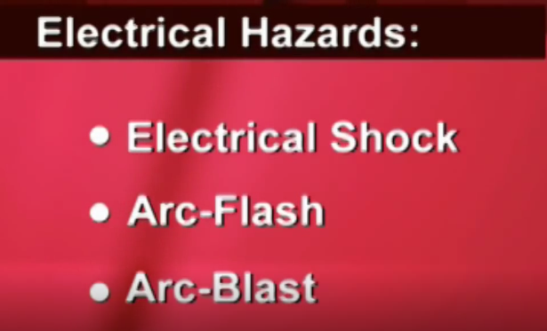
Common Terms – Grounding
Notes:
Common Terms
Grounding – a conductive connection to the earth which acts as a protective measure
Insulators – substances, such as wood, rubber, glass, and bakelite, that have high resistance to electricity
Resistance – opposition to current flow
Tetanic Contraction - a sustained muscle contraction evoked when the motor nerve that innervates a skeletal muscle emits action potentials at a very high rate.
Voltage – Voltage (V) is how strong the "urge" is for the current to flow. Voltage is the push on the electrons. A rough analogy is that current is like water molecules, and voltage is like a slope. The steeper the slope, the more the water molecules wants to flow down it. Zero voltage between two points is like a plateau and, hence, there is no current flow.
Watts – a measure of electrical power. In an electrical system power (P) is equal to the voltage multiplied by the amps. W = V x A

Slide 7
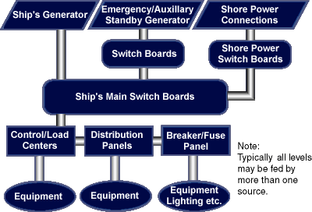
Electrical Sources On-Board Electrical Sources Flow Chart
Notes:
Electrical Sources On-Board (1915.181) (1915.157)
There are two sources of electrical power used during building and repair of a vessel -- shore side and vessel generated. (See diagram). The potential for electrical shock hazards is greater in shipbuilding and repair than in other industries, because workers stand on metal decks and often work in a wet environment. Work on or around energized electrical equipment, or using portable electrical tools, can expose workers to electrocution, burns, or electrical shock. Before work is performed, energized equipment must be locked and/or tagged out, guarded, de-energized, and/or appropriate PPE used to prevent worker exposure.
Never plug into a ship’s power without permission.

Slide 8
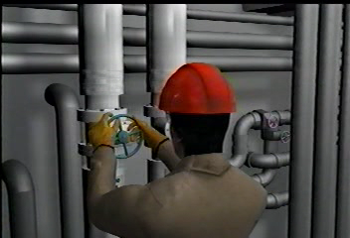
Non-Electrical Hazards Shipyard Worker Closing a Valve
Notes:
Video: Non-Electrical Hazards-What Should Have Been Done Differently?

Slide 9
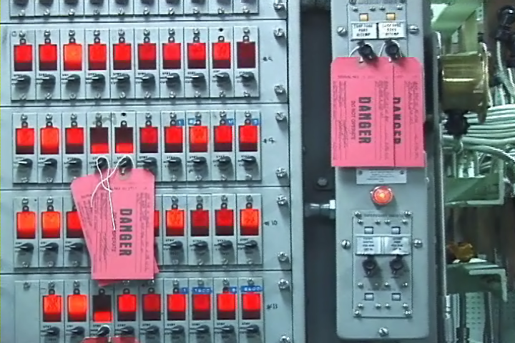
Lockout-Tagout Circuit Board With Red Tags
Notes:
Lockout-Tagout
Lockout-Tagout is a specific work safety procedure or practice that safeguards employees from the unexpected powering or startup of machinery and equipment, or the release of hazardous energy during service or maintenance activities. This training is an overview of the process and is not intended to qualify you to perform Lockout-Tagout procedures.
Start up question!
Lockout-Tagout:
Requires a lock?
Requires a tag?
Requires both?
It depends
Notes:
___________________
___________________
___________________
___________________
___________________
___________________
___________________

Slide 10
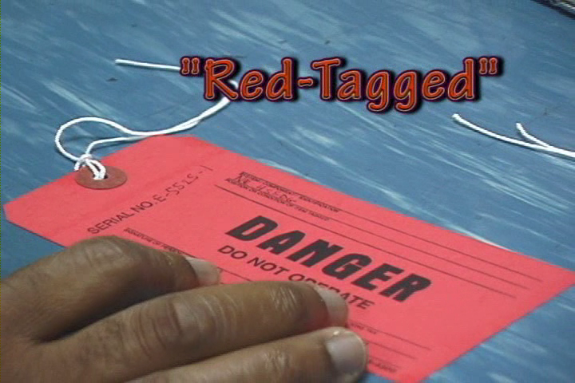
Terminology-Affected Employees Red Tag
Notes:
Affected Employee – An employee whose job requires the operation or use of machines or equipment on which servicing or maintenance is being performed under lockout or tagout, or whose job requires work in an area where such activities are being performed.
Authorized Employee– A person who locks or tags out systems / equipment in order to perform servicing or maintenance on equipment / system. Each authorized employee should receive training in NAVSEA Standard Item 009-24
recognition of applicable hazardous energy sources, the type and magnitude of the energy available on-board, and the methods and means necessary for energy isolation and control. Each employee who is authorized to perform a tagout must be trained in accordance with the Tagout Users Manual S0400-AD-URM-101/TUM.
Lockout – The placement of a lockout device or an energy isolation device.
“Red-Tagged” – On military vessels red tags are used and when a system is tagged out it is often referred to as “red-tagged”.
Work Authorization Form (WAF) – A form submitted by a subcontractor to the Navy requesting that a specific type of work be done on a vessel.

Slide 11
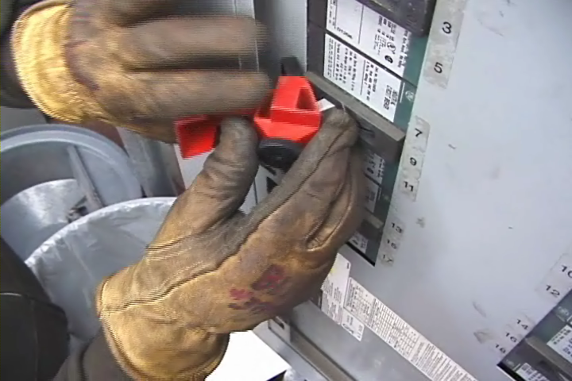
Overcurrent Devices Circuit Breaker
Notes:
Overcurrent Devices
The basic idea of an overcurrent device is to make a weak link in the circuit. In the case of a fuse, the fuse is destroyed before another part of the system is destroyed. In the case of a circuit breaker, a set of contacts opens the circuit. Unlike a fuse, a circuit breaker can be re-used by re-closing the contacts. Fuses and circuit breakers are designed to protect equipment and facilities, and in so doing, they also provide considerable protection against shock in most situations.
However, the only electrical protective device whose sole purpose is to protect people is the ground-fault circuit-interrupter (GFCI) which is not an overcurrent device. A ground-fault circuit interrupter (GFCI) uses a current transformer (CT) (or similar device), to detect slight current imbalances between the ungrounded (hot) and grounded (neutral) conductors that pass through it.

Slide 12
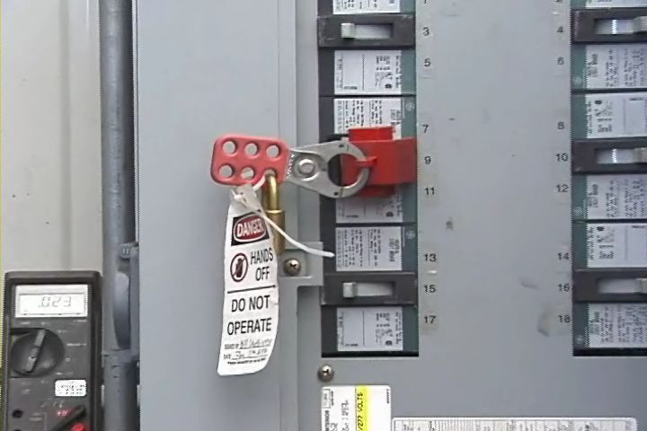
Key Word: De-Energize! Circuit Locked Out and Tagged
Notes:
Key Word: De-Energize! (1915.181)
Before work is performed on circuits, except those being tested or adjusted, circuits must be de-energized and checked at the point where work will be performed to ensure the circuits are actually de-energized.
ALWAYS CHECK AND CHECK AGAIN TO BE SURE!
When testing or adjusting energized circuits, a rubber or other suitable insulated deck mat must be used.
De-energizing the circuit must be appropriately completed by opening the circuit breaker, opening the switch, or removing the fuse.
The circuit breaker, switch, or fuse location must be locked and/or tagged to indicate work is occurring on the circuit. Such tags must not be removed nor the circuit energized until the work has been completed.
When work is performed immediately adjacent to exposed energized parts, these parts must be covered (for example, insulated) or other equally safe means provided.

Slide 13
Hazardous Energy/Terminology
Notes:
13
For each statement below circle T for True or F for False.

Slide 14
Your Companies System Lockout Tagout Graphic
Notes:
Your Companies System
The Lockout/Tagout Plus standard specifies that employers must: establish an energy-control program to ensure that only trained and authorized employees isolate machines from their energy sources and render them inoperative before performing service or maintenance.
General training content. The employer shall train each employee who is, or may be, in an area where lockout/tags-plus systems are being used so they know:
1915.89(o)(2)(i)
The purpose and function of the employer's lockout/tags-plus program and procedures;
1915.89(o)(2)(ii)
The unique identity of the locks and tags to be used in the lockout/tags-plus system, as well as the standardized color, shape or size of these devices;
1915.89(o)(2)(iii)
The basic components of the tags-plus system: an energy-isolating device with a tag affixed to it and an additional safety measure;
1915.89(o)(3)(i)The use of the employer's lockout/tags-plus program and procedures;

Slide 15
Lockout Tagout Piers / Facilities Lockout Device
Notes:
Lockout Tagout Piers / Facilities
There are many different ways to lock out a piece of equipment. Commonly, the main disconnect switch has one opening where a lock can be placed.
When more than one employee works on any equipment, a lockout adapter designed for the installation of several locks must be used, enabling all workers to lock out the machine with their individual locks.
If switches are in a metal box, the box must be locked out.
If a fuse was removed in order to de-energize the equipment, the fuse box must be locked.
If the controls are in a metal covered box, a hasp may be welded or riveted to the door, along with a lock staple. Fuse boxes can also be locked in this way.
Machines activated by compressed air or steam will have valves that control movement. These valves must be locked out and bled down to release any back pressure.

Slide 16
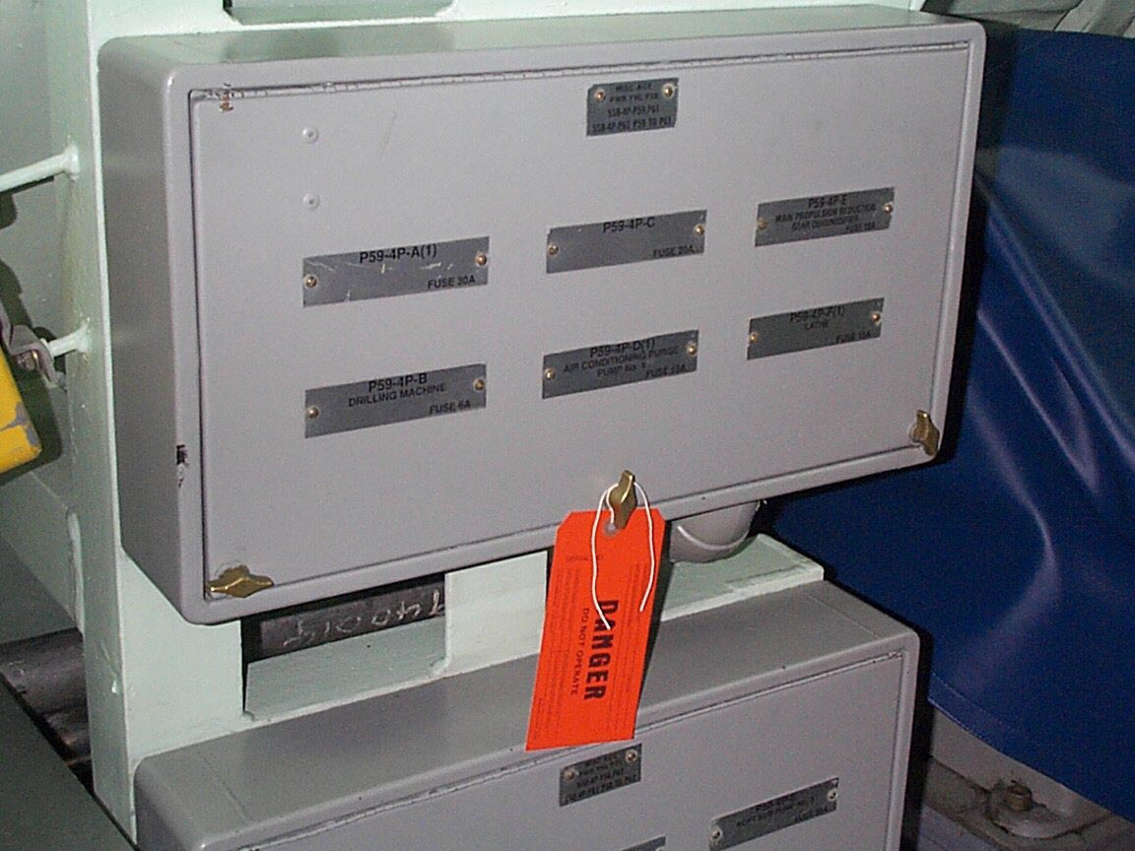
Tagging Out a Navy Vessel Improper Tagout
Notes:
Tagging Out a Navy Vessel
When tagging out on a Navy Ship there are additional and specific requirements. The following training content is subject to change as shipyard rules and governmental regulations change. You should follow your company’s procedures, rules and regulations. You should also study applicable OSHA (Federal and California) and NAVSEA standards and best practices before beginning work.
This is an incorrect method for applying a danger tag to fuses removed from a panel. It is not obvious from which component fuses have been removed.
Note to paragraph (c)(4) of this section: When the Navy ship's force maintains control of the machinery, equipment, or systems on a vessel and has implemented such additional measures it determines are necessary, the provisions of paragraph (c)(4)(ii) of this section shall not apply, provided that the employer complies with the verification procedures in paragraph (g) of this section.
.

Slide 17
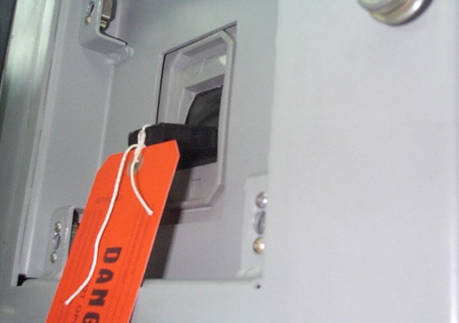
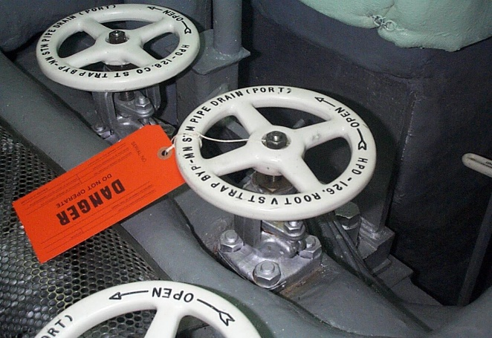
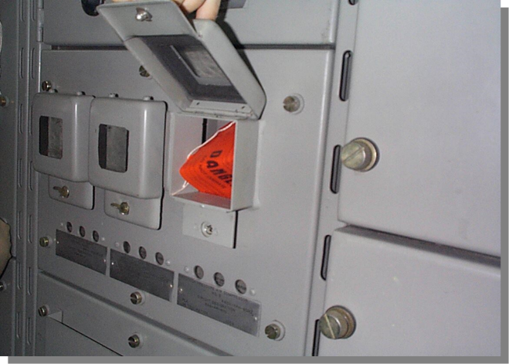
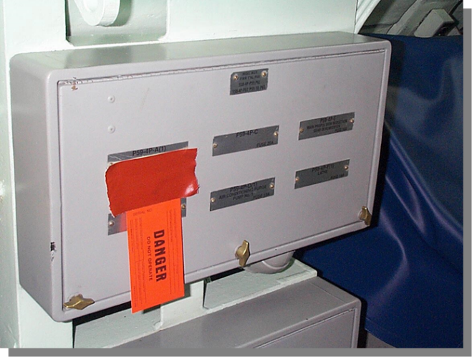
Proper Tag Attachment Correct Tagout Methods On Switches/Valves
Notes:
Proper Tag Attachment
This is the correct way to post a tag on a breaker (large or small). The tag is inserted through the hole on the breaker handle.
This is the correct method for applying a danger tag to a valve. Tags may be placed on the stem in cases where the hand wheel must be removed for maintenance
This is the correct method for applying a danger tag to a recessed breaker. The tag is attached to the breaker handle.
This is the correct method for attaching a danger tag to a power panel. The tag is attached over the label plate in a manner that allows viewing of the plate beneath the tag.

Slide 18
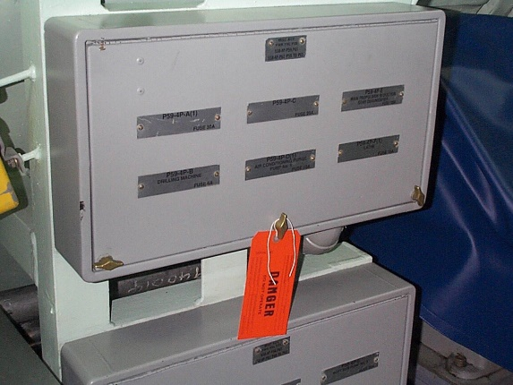
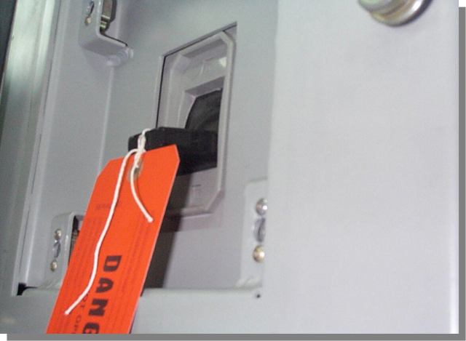
Quiz Tagout Methods On Switches / Valves
A
B
C
D
E
Notes:
Which of the above is incorrect?
Is a tag an Administrative Control or an Engineering Control?

Slide 19
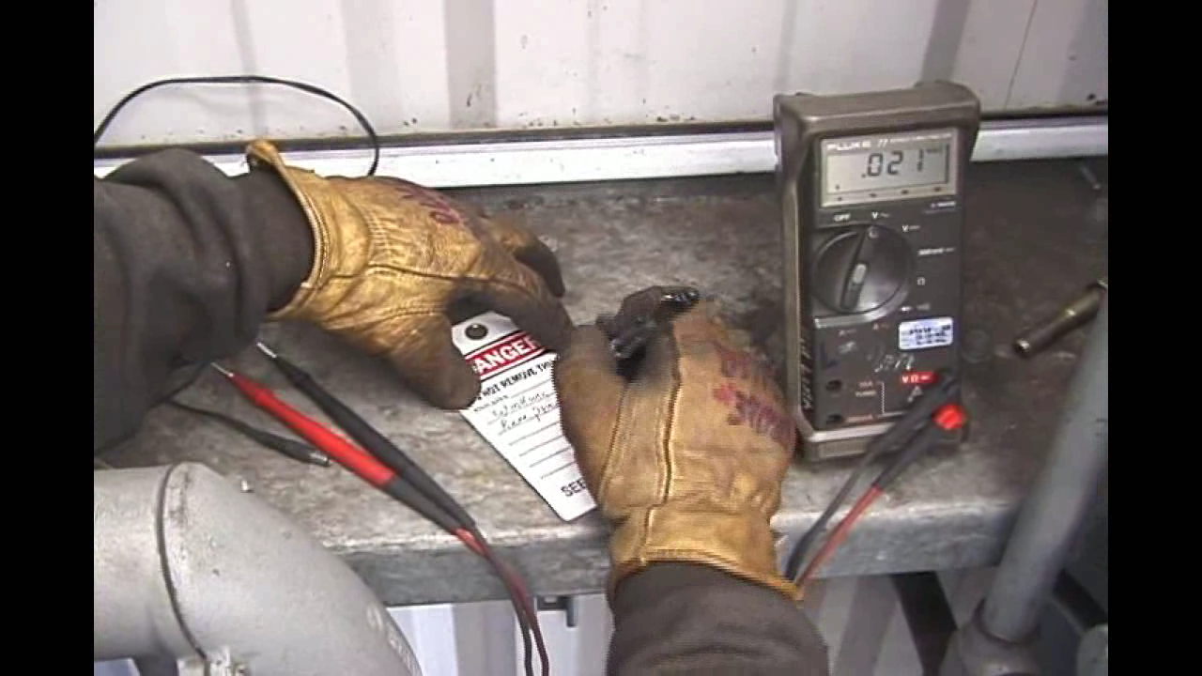
Dos and Don’ts Authorized Person Filling-Out A Tag
Notes:
Dos and Don’ts – Video

Slide 20
The Five Basic Rules
Never
Work on an energized system
Operate any tagged device
Re-energize without proper tag-in
Lock or Tagout a device unless you are authorized
Tamper or remove a lock or a tag
Notes:
Never
Work on an energized device (unless testing)
Operate a tagged device
Re-energize without proper tag-in
1915.89(o)(2)(v) The prohibition against restarting or reenergizing any machinery, equipment, or system being serviced under a lockout/tags-plus system.
4. Lockout or tagout a device unless you are specifically trained and authorized to perform this function!
5. Tamper or remove a lock or a tag
1915.89(o)(2)(iv) The prohibition against tampering with or removing any lockout/tags-plus system;

Slide 21
Additional “Nevers”
Notes:
Never
Plug into ship’s power without permission
Use another contractor’s tag. Your company must initiate a WAF to work on a system
Remove, modify or disturb a lock or a tag (or the device it is affixed to)!
Willfully demonstrate non-compliance with lockout/tagout procedures
Non-compliance with, or violation of, these policies and/or procedures will result in immediate disciplinary action on the first offense up to and including termination

Slide 22
Dos Happy Face with Thumbs Up!
Notes:
Dos
Always test circuit before working on it!
Verify tags
Test at the source
When you see a “floating” tag (a tag no longer attached to a device such as a valve) notify Ship’s Force and your Supervisor immediately
Close Calls: Report a “little shock”
Re-Test at the source!

Slide 23
Take Action!
Notes:
Take Action!
When you find equipment that is defective, in need of repair or unsafe:
Turn off equipment to protect yourself
Place a warning tag or barrier on the equipment to prevent others from using it
Notify your supervisor of the condition

Slide 24
In Case Of An Emergency Cartoon of Man Being Shocked!
Notes:
In Case Of An Emergency
Do not touch someone being shocked!
Call for help
Secure power immediately
Remove them from the source with a non-conducting material, such as something made with rubber or plastic (be sure the material is not wet)
After the person is removed from the source, start CPR if necessary and you are trained!

Slide 25
Training
Notes:
Training
OSHA 1915.89(o)(2) General training content. The employer shall train each employee who is, or may be, in an area where lockout/tags-plus systems are being used.
Training is to be conducted with any new employee that will be involved with shipboard tagout.
Annual training will be given to all authorized employees.
OSHA 1915.89(o)(7) Upon completion of employee training, the employer shall keep a record that the employee accomplished the training, and that this training is current. The training record shall contain at least the employee's name, date of training, and the subject of the training.
OSHA 1915.89(o)(6) (i) through (iii) Employees may need re-training based on new job assignments, equipment changes, procedure changes, proficiency changes, program investigations and/or audits, or evidence that there is a lack of knowledge. Re-training must ensure the required employee knowledge and proficiency in the employer’s program and procedures.

Slide 26
Circle the Best Answer
Notes:
26

